Slide 1
Progress towards the gender responsive SDGs in Africa at regional, subregional, and country levels
Joint AfDB - UNECA -UN Women-PARIS21 - HCP
Africa Gender Statistics Forum
7-11 November 2023, Casablanca, Morocco.
The African Centre for Statistics ACS
United Nations Economic Commission for Africa

Slide 2
Contents
Methodology of tracking progress towards the SDGs in Africa
Africa SDG Progress
Progress in achieving SDG 5 in Africa
Data Availability Assessment of SDG 5
Way forward

Slide 3


Methodology of tracking progress towards the SDGs in Africa
Two principal measures are used to assess regional and sub-regional progress towards the SDGs:
The Current Status Index (CSI)
It measures progress towards achieving a specific SDG target since 2000, in other words, how much progress has been made since 2000?
When the desirable direction is increasing or decreasing
TV = Target Value (2030)
𝐼0 = Value of the indicator I for the start year (2000)
𝐼𝑐v = Value of the indicator I for the current year (2022)
For parity indicators

Slide 4

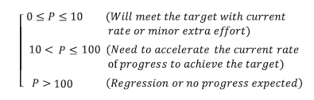
Methodology of tracking progress towards the SDGs in Africa
The Anticipated Progress Index API
It measures the gap between the expected/projected and targeted progress by 2030, how likely will the target be achieved by 2030?
API =
TV = Target Value (2030)
I_{target} = Predicted value of the indicator I for the target year (2030)
I_{base} = Value of the indicator I at the base year (2015)

Slide 5
Methodology of tracking progress towards the SDGs in Africa
Selection of the indicators
Indicators are selected based on the availability of two or more data points for more than 40% of the countries in the respective country grouping.
Data source: https://unstats.un.org/sdgs/indicators/database/
Leaving no one behind – vulnerable group identified when demographic disaggregation is available
Target Setting
Direct Method (implicit or explicit targets values) for almost one third of SDG indicators
Champion area approach: Average growth rate of the top five performers

Slide 6
Gender-Relevant SDG Indicators
Out of the 232 SDGs indicators there are 85 indicators are Gender-Relevant SDG (37%)
Gender-Relevant SDG Indicators are mainstreamed in 13 SDGs goals.
Around three-fourths of SDGs gender indicators are sex disaggregated indicators.

Slide 7
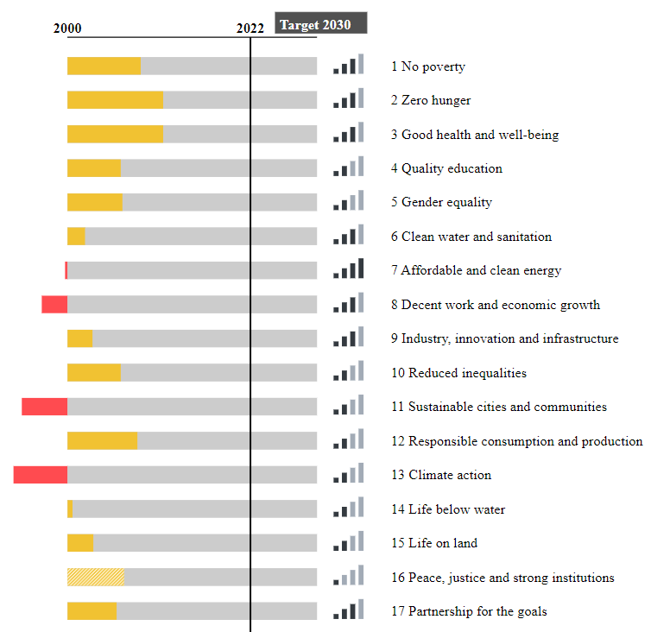
SDGs Progress at a Glance
Africa is making progress in 13 of the 17 SDGs, however the current pace of progress is insufficient to achieve the goals by 2030.
Goal 2: Zero Hunger and Goal 3: Good Health and Well-being have relatively higher progresses than the rest of SDGs.
Goal 16 suffers most in terms of data availability.
SDG progress varies across countries and sub regions. Southern and Eastern Africa perform relatively better than the rest of the sub regions.
Morocco, Mauritius, Rwanda, Seychelles and Guinea-Bissau are the top five performers, whereas Sierra Leone, Angola, Sudan, Chad and Equatorial Guinea are the lowest performers on the continent.
ACCELERATE progress to achieve target
Regression
Insufficient data
Data availability strength

Slide 8
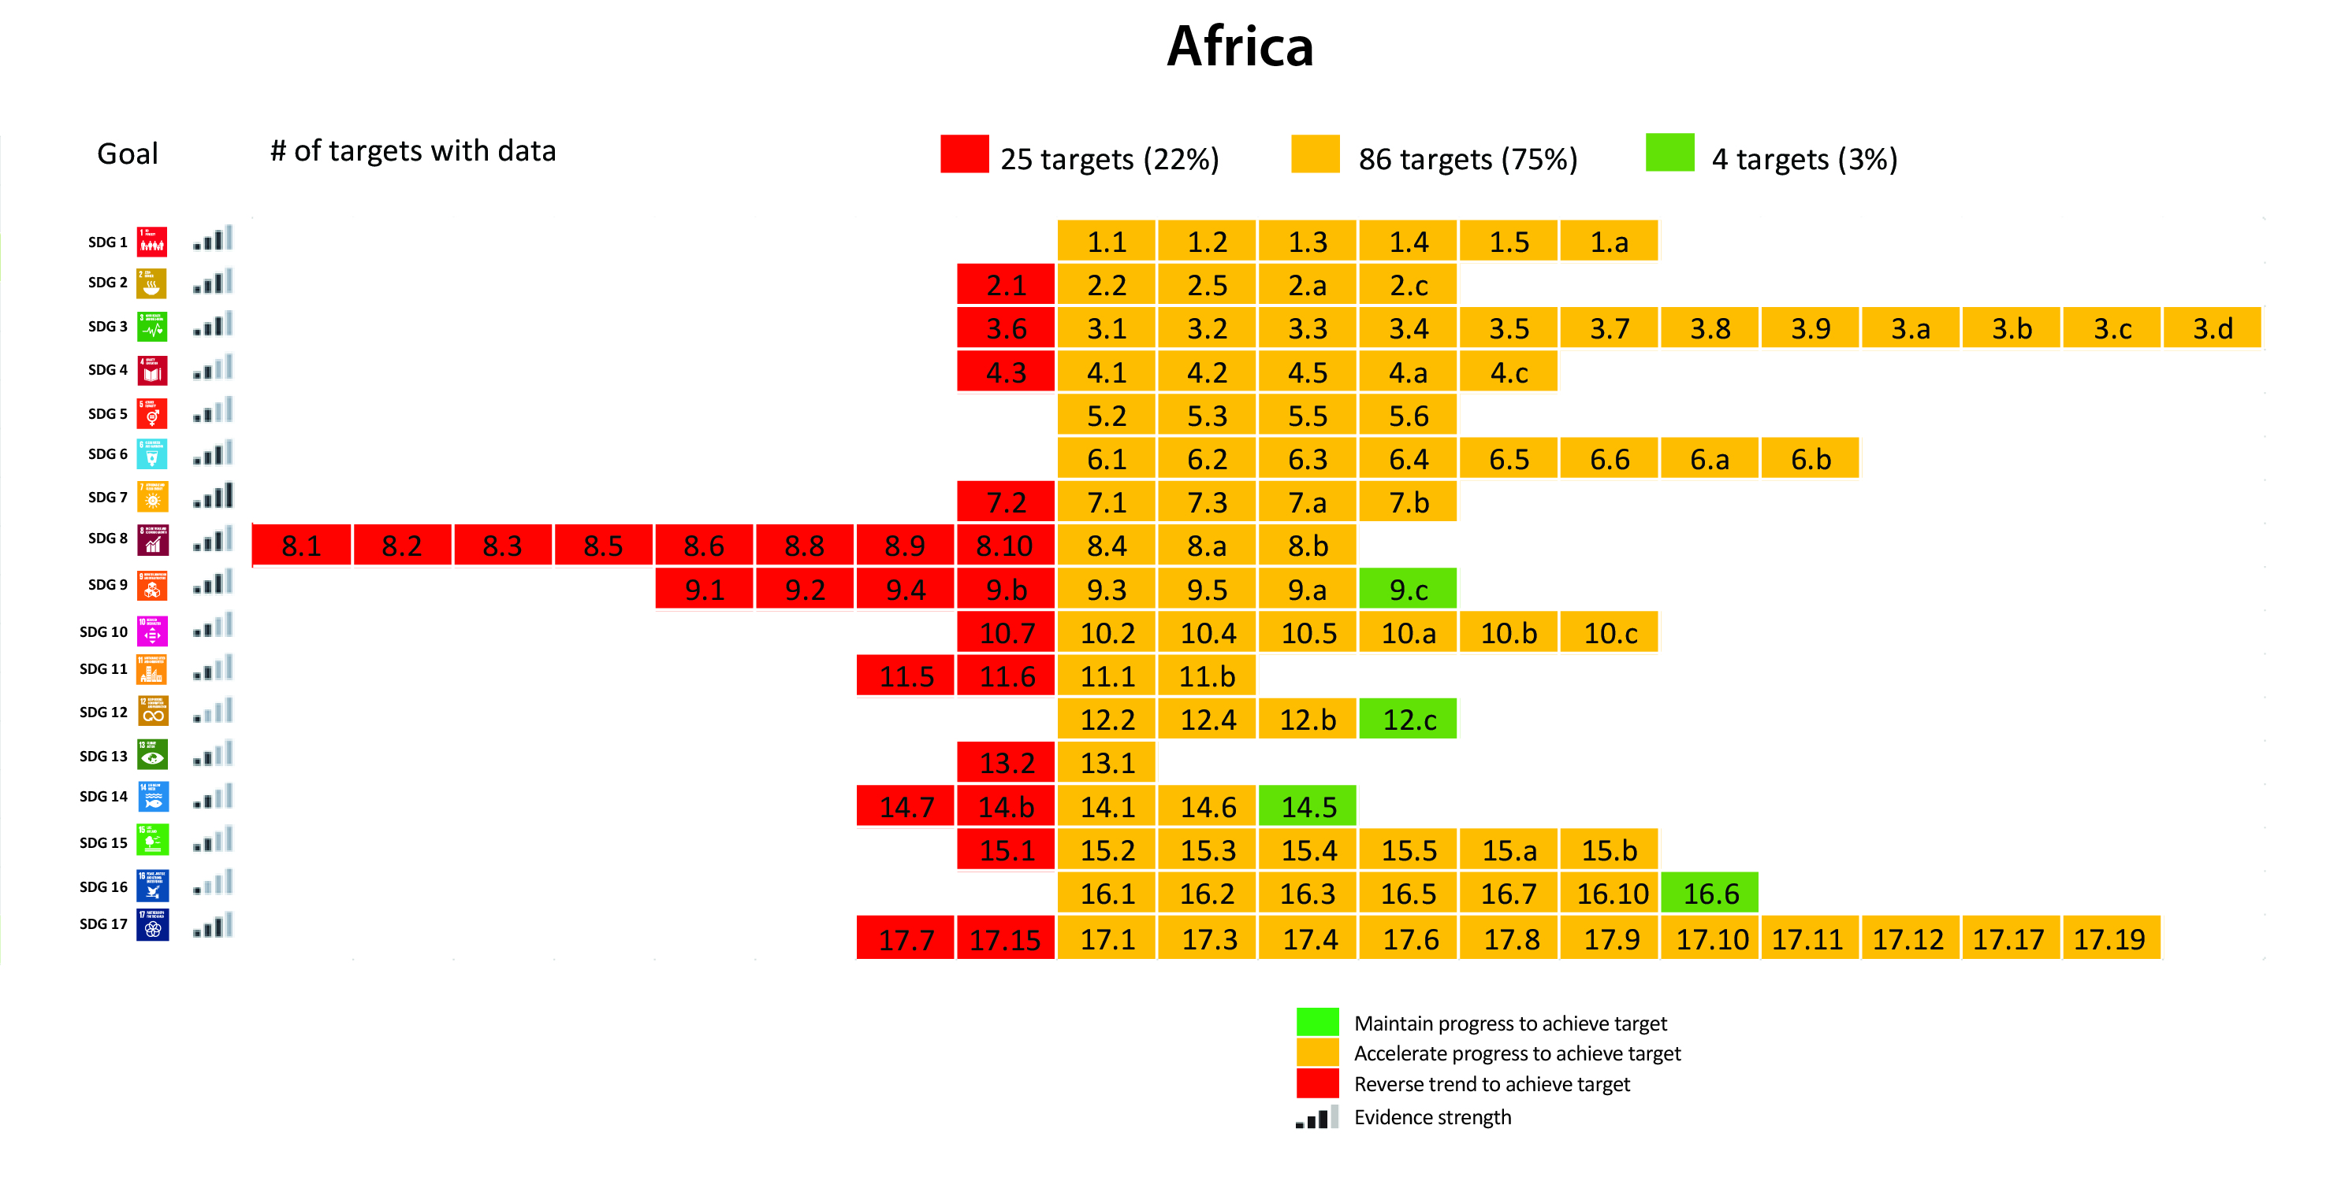

Africa SDGs Status
Progress is assessed for 115 out of the 169 targets due data challenges:
Data collection challenges such as irregularity of conducting surveys and using innovative tools
Challenges in using data sources such as administrative data and Big Data
Timely sharing of data by member States
Lack of disaggregation of data by different groups

Slide 9
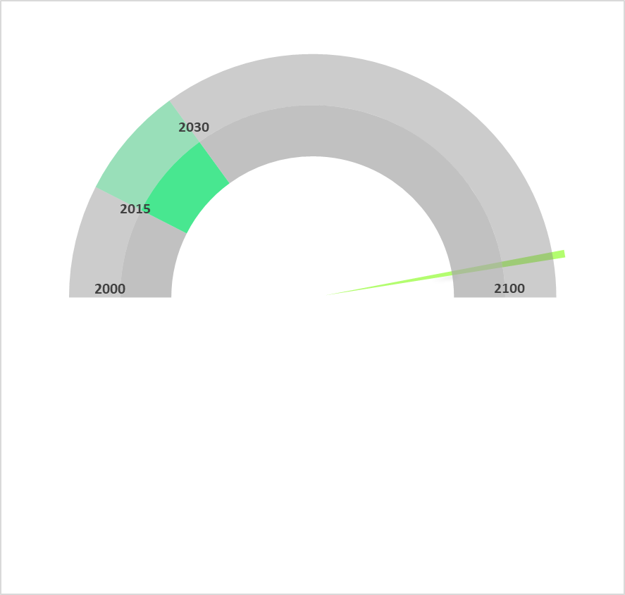
Progress in achieving SDG 5 in Africa
Africa has made a progress in achieving goal 5, however the pace of progress is not enough to achieve the goal.
No target under goal 5 is on track
None of Africa sub regions are on track to achieve Goal 5. However, West and East Africa perform relatively better than the rest of the sub regions.
Goal 5 will be achieved by 2094

Slide 10
Progress in achieving SDG 5 in Africa
2030 target
Significant progress has been on Women in leadership

Slide 11
Progress in achieving SDG 5 in Africa and the five sub regions
None of Sub regions are on track on any target out of the 9 targets of goal 5
A significant number of targets could not be measured at the sub regional level due to data insufficiency.

Slide 12
Progress towards achieving SDG Goal5 by country
2030 target

Slide 13
https://ecastats.uneca.org/unsdgsafrica/SDGs/SDG-progress-2023

Slide 14
Data availability Assessment for SDG 5
Data availability progress
ACS significantly contributed to this improvement though compiling the historical data for 3 indicators 5.2.1, 5.3.1 and 5.3.2
Sufficient data refers to at least two data points are available

Slide 15
Data Availability Assessment of SDG 5 by country
Ethiopia, Uganda, Kenya, Nigeria, Rwanda and Tanzania
Have better positions in terms of data availability (at least two data points are available for more that 50% of the indicators)
While, Botswana, Eswatini, Seychelles, Equatorial Guinea, Libya and South Sudan have only 2 indicators or less with sufficient data.

Slide 16
SDG Data Disaggregation

Slide 17
Way forward
The assessment is based on the available data and results might change as more data are collected and compiled
Integrating different data Sources: Combining data from different sources – such as administrative data, surveys, censuses, and big data to monitor the gender relevant SDGs Indicators;
Investment in Data and Capacity: Building the capacity of national statistical systems particularly the application of new data sources
Call for all data producers to collect and disseminate their data in a sex-disaggregated format;
Engage with countries for specific assessment at the country level

Slide 18
THANK YOU!

