Slide 1


Progress towards the gender responsive SDGs -TANZANIA
Casablanca : Morocco
7-11th November, 2023

Slide 2
Outline
1
Introduction
Voluntary National Review (VNR) Report
Progress in Goal No. 5
Where are we today in SDG? – achievements, and lessons
Hopes for the future
2
3
4
5

Slide 3
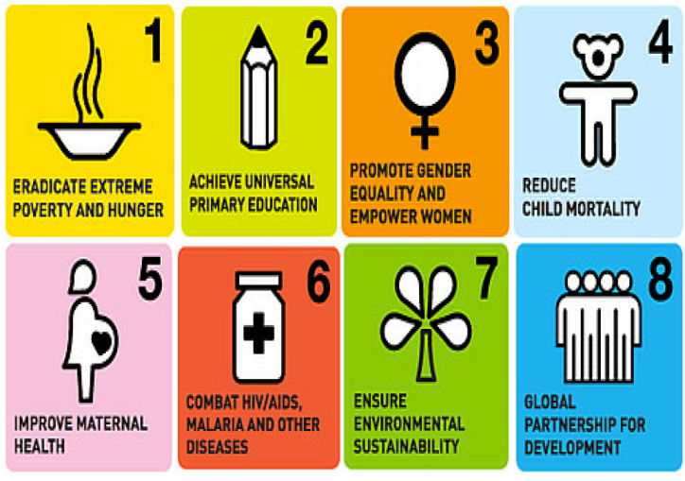


Introduction – Global Perspectives
MDGs
V.S
SDGs
17 Goals – 169 Targets – 231 unique Indicators/
248 Repeating Indicators
8 Goals – 18 Targets – 60 Indicators
Time for Implementation – 15 Years
Time for Implementation – 15 Years
Increase in demand for data
Increase in data
Increase in data problems
Notes:
aaa

Slide 4
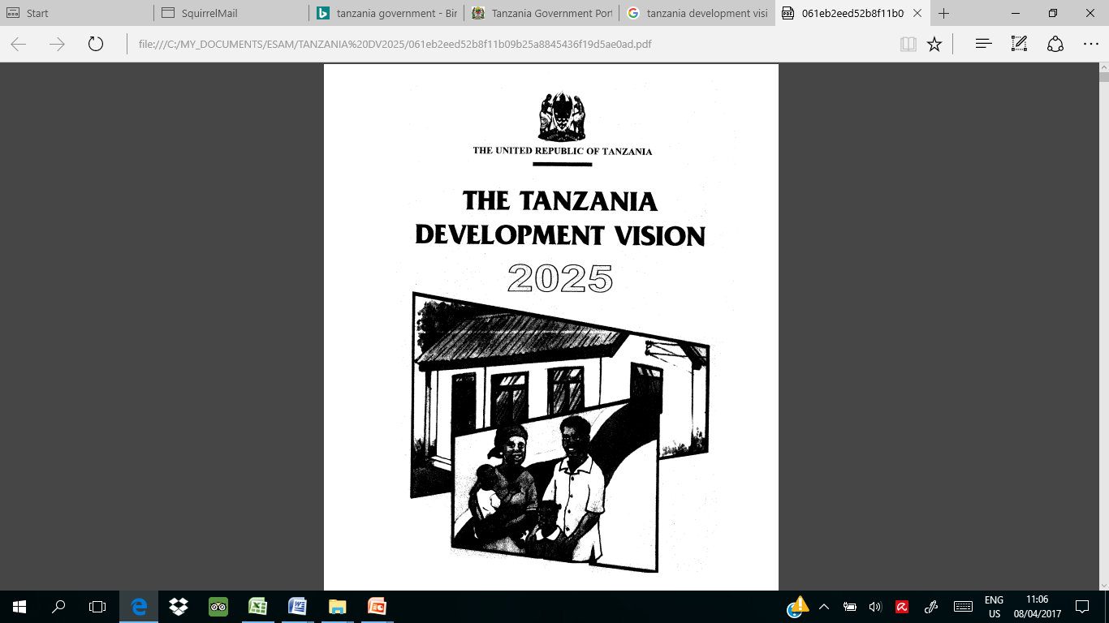


Introduction – National Perspectives
Tanzania
Vision 2025
LTPP 2010 -2025
MKUZA III/FYDP II/ FYDP III/ZADEP
Thematic /Priority Areas
Sector
Indicators
Sub Sector
FYDP II/MKUZA III and FYDP III/ZADEP strongly link between Thematic / Priority area, Sector, sub sectors and indicators
SDGs considered during the design of both ZADEP & FYDP III and MKUZA II/FYDP II facilitated mapping exercise.
Notes:
LTPP – Long Term Percespective Plan

Slide 5
Introduction – Other Development Frameworks
Global Goals
SDGs, 2030+
Data for What?
Improved Decision-Making and Policy
Increased Citizen Empowerment
Increased Innovation and Entrepreneurship
Africa
Agenda 2063
Tanzania
Vision, 2025
FYDP II/MKUZA III
EAC
Vision 2050
Support decision making, Monitor and Evaluate the Performance of Global, Regional and National Dev. Programmes
Notes:
+e.g. the Paris Climate Agreement; Sendai Framework

Slide 6
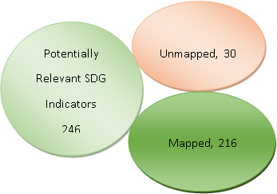
SDGs and MKUZA III/FYDPII/FYDP III/ZADEP Gaps Assessment: Alignment of Potentially Relevant SDGs Indicators with FYDP II/FYDP III and Sector Strategies, June 2023
Notes:
Work on indicators production continuing. To be update every six months as new indicators become available

Slide 7


VNR Report

Slide 8
Table: Availability of Data for Monitoring Progress in SDGs Implementation, June 2023 by Goals
Doing relatively well on data availability:
Goal 5. Achieve gender equality and empower all women and girls (92.9%)
Goal 8. Promote sustained, inclusive and sustainable economic growth, full and productive employment and decent work for all (87.5%)
Goal 1. End poverty in all its forms everywhere (84.6%)
Goal 3. Ensure healthy lives and promote well-being for all at all ages (67.9%)
Notes:
Not doing so well in terms of Data availability:
Goal 16: Promote peaceful and inclusive societies for sustainable development, provide access to justice for all and build effective, accountable and inclusive institutions at all levels.
Goal 15. Protect, restore and promote sustainable use of terrestrial ecosystems, sustainably manage forests, combat desertification and halt and reverse land degradation, and halt biodiversity loss.
Goal 10. Reduce inequality within and among countries
Goal 12. Ensure sustainable consumption and production patterns.

Slide 9
Goal 5. Achieve gender equality and empower all women and girls (92.9%)
The Government has continued to implement programmes to empower women with the aim of increasing economic opportunities and building business capacity, access to capital, markets and credit facilities. The Government continued to support training which has enabled women to attain key business skills
Increased opportunities for girls’ education and training, swift measures against discrimination concerning land ownership and inheritance, violence against women and girls, and an intensified voice against archaic cultural biases against women
Tanzania has in place the National Plan of Action for Ending Violence Against Women and Children, which addresses measures to end gender-based violence.

Slide 10
5.1 End all forms of discrimination against all women and girls everywhere
5.1.1 Whether or not legal frameworks are in place to promote, enforce and monitor equality and non-discrimination on the basis of sex
The Criminal Procedure Act 7/2018 section 151 (1) has provisions that do not allow for provision of bail for any person accused of GBV related cases, as well as increase of sentences that the courts may pass. For instance, at Regional Courts on GBV cases
from 7 years to 14 years and for High Court from 30 years to life imprisonment upon
conviction.

Slide 11
5.1 End all forms of discrimination against all women and girls everywhere
5.1.1 Whether or not legal frameworks are in place to promote, enforce and monitor equality and non-discrimination on the basis of sex
As regard to Concerning the recommendation No 11(b) CEDAW/C/TZA/CO/7-8, the Government amended the Penal Code Cap. 16 vide by the Written Laws (Miscellaneous Amendment) Act No 2 of 2016 whereby Female Genital Mutilation (FGM) against a person above 18 years of age is prosecuted as an offence of grievous bodily harm. The Government in mainland Tanzania is further in the process of reviewing the Law of Marriage Act, Cap. 29 to conform to the Court of Appeal decision in the case of Attorney General vs Rebecca Z. Gyumi, Civil Appeal No. 204 of 2017 on raising the age of marriage of a girl to 18 years. The NPA-VAWC prioritizes the Law of the Marriage Act; Customary Declaration Order (on women inheritance law).

Slide 12
5.2 Eliminate all forms of violence against all women and girls in the public and private spheres, including trafficking and sexual and other types of exploitation

Slide 13
5.2.1 Proportion of ever-partnered women and girls aged 15 years and older subjected to physical, sexual or psychological violence by a current or former intimate partner in the previous 12 months, by form of violence and by age (TDHS –Age 15-49)

Slide 14
5.2.2 Proportion of women and girls aged 15 years and older subjected to sexual violence by persons other than an intimate partner in the previous 12 months, by age and place of occurrence (TDHS data is at Age 15-49 Years)
15-49 = 0.3% 2022 TDHS-MIS
15-19 = 1.5 %
20-49 = 0.0%
Urban Areas = 0.4 %
Rural Arears = 0.3%
The TDHS-MIS show only 1.5 percent of women age 15-19 years experienced violence by someone other than a husband/intimate partner among the women age 15-49 years.
Administrative data shows that it happen in Home of perpetrators

Slide 15
5.3 Eliminate all harmful practices, such as child, early and forced marriage and female genital mutilation

Slide 16
5.3.1 Proportion of women aged 20-24 years who were married or in a union at exact age 15 and 18
Age 15
5.2%
5.2%
Age 18
30.5%
29.1%
2015-16 TDHS-MIS
2022 TDHS-MIS

Slide 17
5.3.2 Proportion of girls and women aged 15-49 years who have undergone female genital mutilation/cutting, by age

Slide 18
5.4 Recognize and value unpaid care and domestic work through the provision of public services, infrastructure and social protection policies and the promotion of shared responsibility within the household and the family as nationally appropriate

Slide 19
5.4.1 Proportion of time spent on unpaid domestic and care work, by sex, age and location (15 years and above)-ILFS

Slide 20
5.4.1 Proportion of time spent on unpaid domestic and care work, by sex, age and location (15 years and above)-ILFS –Tanzania Zanzibar -ILFS

Slide 21
5.5 Ensure women’s full and effective participation and equal opportunities for leadership at all levels of decision making in political, economic and public life

Slide 22
5.5.1 Proportion of seats held by women in (a) national parliaments and (b) local governments

Slide 23
5.5.2 Proportion of women in managerial positions
Women in Managerial positions include Ministers, Permanent secretaries, Regional and District Commissioners, District Executive Directors, District Administrative Secretaries, Ambassadors, Judges, Directors
Source: Presidents office, Public Service Management
27.4%
27.4%
27.4%
28.9%
2019
2020
2021
2022

Slide 24
Tanzania Top Women Leaders
The country has made progress towards advancing gender equality in leadership and decision making at all levels, with more women being appointed to lead key positions. At the highest level, the URT President is a Woman - Her Excellency, Dr. Samia Suluhu Hassan, the Speaker and Clerk of the National Assembly (Tulia Ackson) are women (She has also elected in Inter Parliamentary Union (IPU)), and 35 percent of Ministers are women. For the first time in history, in Zanzibar the Chief Secretary is a woman, and the Deputy Speaker and Clerk of the Zanzibar House of Representatives are women

Slide 25
5.6 Ensure universal access to sexual and reproductive health and reproductive rights as agreed in accordance with the Programme of Action of the International Conference on Population and Development and the Beijing Platform for Action and the outcome documents of their review conferences

Slide 26
5.6.1 Proportion of women aged 15-49 years who make their own informed decisions regarding sexual relations, contraceptive use and reproductive health care (2022 TDHS-MIS)

Slide 27
5.6.2 Number of countries with laws and regulations that guarantee full and equal access to women and men aged 15 years and older to sexual and reproductive health care, information and education

Slide 28
5.a Undertake reforms to give women equal rights to economic resources, as well as access to ownership and control over land and other forms of property, financial services, inheritance and natural resources, in accordance with national laws

Slide 29
5.a.1 (a) Proportion of total agricultural population with ownership or secure rights over agricultural land, by sex; and (b) share of women among owners or rights-bearers of agricultural land, by type of tenure

Slide 30
5.a.2 Proportion of countries where the legal framework (including customary law) guarantees women’s equal rights to land ownership and/or control
Land Tenure Act of 1992 –Zanzibar and Land Act 1999 of Tanzania Mainland
Village land Act of 1999
Both allows women, children or persons with disability lawful access to ownership, occupation or use of land

Slide 31
5.b Enhance the use of enabling technology, in particular information and communications technology, to promote the empowerment of women
5.b.1 Proportion of individuals who own a mobile telephone, by sex

Slide 32
5.c Adopt and strengthen sound policies and enforceable legislation for the promotion of gender equality and the empowerment of all women and girls at all levels
5.c.1 Proportion of countries with systems to track and make public allocations for gender equality and women’s empowerment
On Gender Responsive Budgeting (GRB), the Government through the Ministry of Finance (MoF), integrated gender targets for the first time in its Public Financial Management Reform Programme (PFMRP) in three of the five strategic objectives in the PFMRP Strategic Plan (2022-2027).
The Government established a GRB core team at MoFP, to provide technical guidance to accelerate the mainstreaming of gender perspectives into all MDA operational mechanisms.

Slide 33
Where we are today-SDGs? – achievements, and lessons
Stakeholders awareness of the global agenda for sustainable development is growing, a community of practice is emerging.
Alignment of SDGs and the FYDP II/MKUZA III/FYDP III/ZADEP indicators mapped, documented.
Current capability of the national statistics system to meet demand for national data for sustainable development known, documented.
Sources and relative supply expectations mapped and assessed (data sources, institutional partners (55.2% of data from any source is available)
1
2
3
4

Slide 34
Where we are today? – achievements, and lessons…
Some data available & indicators are aligned with national priorities, but gaps still exist;
Some thematic areas are already doing relatively well in terms of availability of national level data, others are struggling & require intensive support;
Huge demand for filling the gap on availability of URT indicators vs Mainland and Zanzibar;
Disaggregated data, sub-national/local granular data availability still a challenge
1
2
3
4
Notes:
Leave no one behind

Slide 35
What next? – hopes for the future
Putting and keeping the financing for data on the list of institutional and national priorities (more and better/efficient use of resources).
Facilitating comprehensive data capture from Administrative Sources specifically from TSMP II.
Building a more comprehensive statistical database on the United Republic of Tanzania.
(e.g. improved data capture forms; smart tools and solutions to capture and ease processing and flow of massive data)
Collaboration with non-state actors and the International Data Community
  Clear, easy to understand guidelines for onboarding/validation/approval of third party data
Working on dissemination platforms such as SDG Goal Tracker Portal for Tanzania.
1
2
3
4
5

Slide 36

Thank you for listening

