Slide 1


Presentation of Mauritius in mainstreaming gender into Agenda 2063
This presentation depicts the progress achieved and challenges in meeting the goals 17 and 18 and targets under Aspiration 6 of the Agenda 2063
7-11 November 2023, Casablanca, Morocco

Slide 2
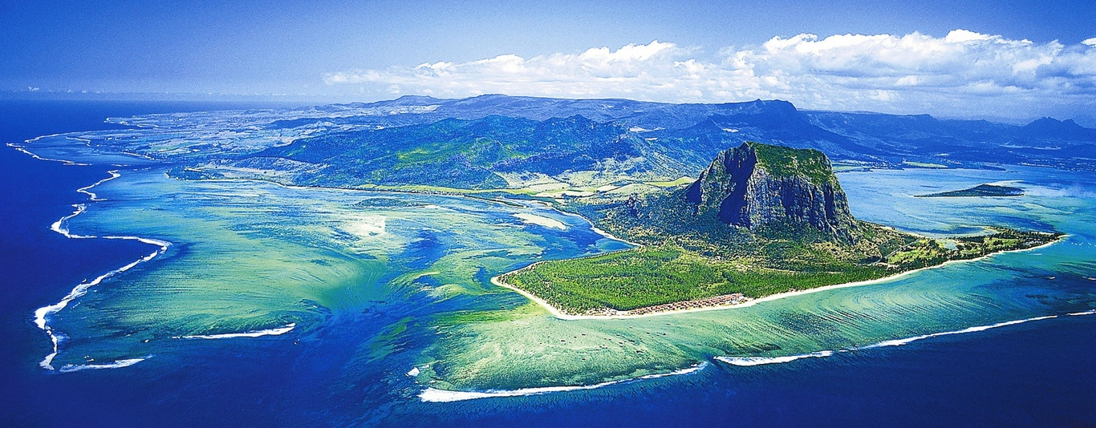
Mauritius has over the years aligned its policies and programmes with the UN Agenda 2030 and AU Agenda 2063, and has been consistent in translating into actions its commitments made towards women’s empowerment and gender equality.

Slide 3
Aspiration 6 : An Africa whose development is people driven , relying on the potential of the African people
Goal 17: Full Gender Equality in all Spheres of life
Goal 18:Engaged and Empowered Youth and Children

Slide 4
Proportion of women in total agricultural population with ownership or secure rights over agricultural land
Proxy indicator: % of total female population in employment
2019: 38.5% 2022: 38.8%

Slide 5
More indicators to show women’s participation……
Proportion of women engaged as employer and own account worker:
2019:10.2% 2022:10.4%
Gap in earnings between women & men
Women earned 76% in 2019 & 78% in 2022
of what men earned .

Slide 6
Women’s Economic Empowerment
The National Women Entrepreneur Council provides training, loans, and marketing assistance for women entrepreneurs
The government provides interest-free loans up to Rs 500,000 for women starting new business.
A groundbreaking budgetary measure announced for this Financial year which has acted as a game changer has been the promotion of gender equality at all levels, listed companies shall have a minimum of 25 percent of women on their boards.

Slide 7
Proportion of seats held by women in national parliaments, regional and local bodies
Proportion of seats held by women in the Mauritius National Parliament:
2014: 11.6%
2022: 20.0%
4 women ministers out of 23 ministers (17.4%)
4 women parliamentary private secretaries (PPS) out of 11 PPS (36.4%)

Slide 8
Women’s participation
Village Council Election (Year 2021):
274 women were elected out of 1170 candidates (23.4%)
Rodrigues Regional Assembly:
2013 : 5 women were elected out of 21 (23.8%)
2022: 5 women were elected out of 17 (29.4%)
Women holding senior positions in government services:
2019 : 39.1% 2022: 38.6%

Slide 9
Proportion of women and girls subjected to sexual and physical violence
Proxy indicator “Number of domestic violence cases of physical and sexual violence per 100 female population aged 18 yrs and over”
2019:0.16%
2022:0.33%

Slide 10
Proportion of Domestic Violence cases of physical and sexual violence per 100 female population aged 18 years and over

Slide 11
Multiple initiatives have been taken to address and prevent violation against women in Mauritius
A mobile App called ‘’LESPWAR’’ was launched in 2020 to enable victims of Gender-Based Violence to rapidly connect with the Police Main Command and Control Centre.
The Government has adopted a National Strategy and Action Plan on the elimination of Gender-Based Violence(2020-2024)

Slide 12
Indicators related to Goal 17
Proportion of girls & women aged 15-49 years who have undergone female genital mutilation/cutting by age
Not relevant given that there are no such social norms and customary practices against women in Mauritius
Indicator- Proportion of children whose births are registered in the first year
Proportion of children whose births are registered in the 1st year in Mauritius is 99%
Gender parity index (GPI) =1.0 for pre-primary, primary and secondary indicating no disparity

Slide 13
Goal 18- Engaged and Empowered Youth & Children
Indicator- Unemployment rate of youth
Youth unemployment rate:
2019: 22.8% 2022: 25.1%

Slide 14
Government has set up the following programmes
Youth Empowerment Programme (YEP)
Service to Mauritius
Trainee Engineer Scheme
Dual Training Programme
National Skills Development Programme
‘Prime de L’Emploi’

Slide 15
Indicators related to Goal 18
Indicator : % of children engaged in child marriage
Proxy indicator used: % of women aged 16-17 years who got married civilly per 100 female population in the same group has been used:
2019: 0.7% 2022: 0.1%
Indicator - % of children who are victims of human trafficking
Proxy indicator used– Number of children victims of trafficking per 100 population aged below 18 years has been used
Since 2013 = Less than 1%

Slide 16
Indicator – Level of implementation of the provisions of the African Youth Charter (AYC)on the Rights of the Youth by Member States
Mauritius signed the AYC in 2006 and ratified same in 2008, focusing on youth participation, sustainable livelihood, health, leisure and cultural activities, empowerment of young women and poverty eradication.

Slide 17
Measures taken for Child Protection and Development
New Children's Act focusing on child rights
The Children's Act 2020 proclaimed in January 2022 made provisions to safeguard child rights
Child protection services and hotline
The Child Development Unit provides protection services for abused children and operates a 24/7 toll-free hotline for reporting case
Budget allocates funds for childcare centers and facilities
The 2023/2024 budget allocated funds for setting up childcare centers under PPP and workplace childcare facilities

Slide 18
In 2021, the International Organisation for Immigration(IOM) developed Standard Operating Procedures and Tools for identification and care of victims of Trafficking in Persons for Mauritius.
The 2022-2026 National Action Plan to combat trafficking was launched.

Slide 19
THANK YOU!

