Slide 1
What is the care economy?
This product is based on the UN Women online training materials ‘Introduction to the Care economy’ that can be accessed here: https://portal.trainingcentre.unwomen.org/product/introduction-to-care-work-and-care-economy/
as well as on the IMF-UN Women-Africa Training Institute online training materials ‘Unpaid work and the care economy

Slide 2
A care sensitive approach: a bottom-up perspective
Socio-economic system
Interaction between the social and economic activities of countries, communities and individuals. All economic activities that involves people require
an element of care.
25%
Care supports the socioeconomic system
Care is the base of development. But this base frequently remains invisible and is not granted the priority it deserves. That is why we say that care is the base of the iceberg.
When referring to the ‘care system’ we refer to the invisible base.
75%
Notes:
Care is the invisible part of the iceberg. It is much bigger than the visible part of the economy and if it came to disaggregate or break, the visible economy would be lopsided

Slide 3
What is care work ? care work?

Slide 4

Physical and emotional care
Care is comprised of all those activities necessary to re-create, day after day the physical and emotional well-being of people..

Slide 5

Appropriate and satisfying care
Well-being is not only a matter of material resources.
One needs food to avoid hunger, but this food should be culturally appropriate to fully satisfy us. We must also be able to choose with whom we want to share it.
Care must be appropriate to our circumstances and satisfying to ensure that we have what we need.

Slide 6
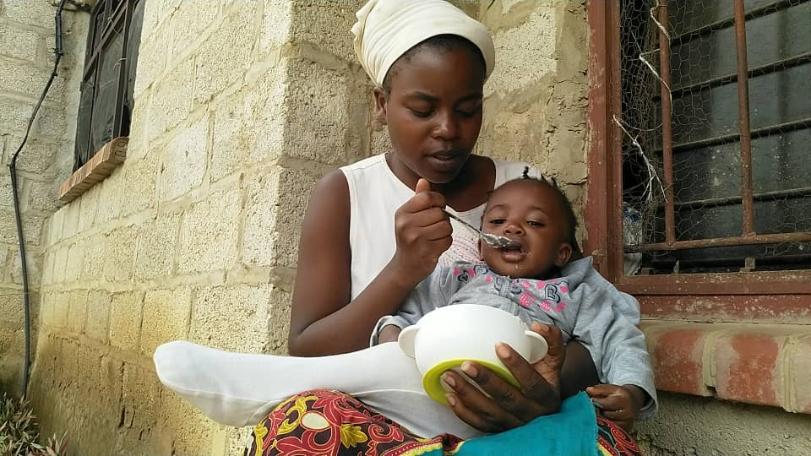

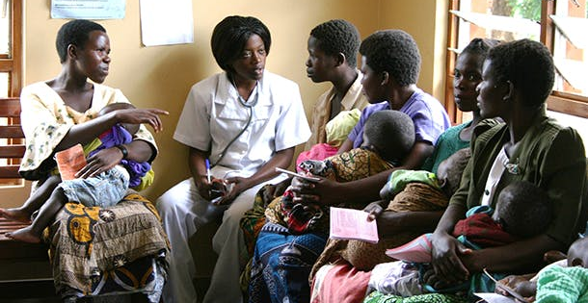
Components of care
DIRECT CARE
PRE-CONDITIONS
FOR CARE
MENTAL
MANAGEMENT
Notes:
Direct care comprises tasks that involve the direct interaction between people in the interest of physical and emotional health. For example, a parent feeding a child, a neighbour caring for a sick neighbour.
Pre-conditions of care are tasks that lay out the materials conditions, which allow for direct care to take place. We sometimes call this unpaid domestic and care work. Examples include preparing food to feed the family clearing cleaning the house, washing and ironing clothes.
Mental management consist of tasks such as coordination, planning and supervision which are of critical to providing care. Although not easy to quantify in terms of time, these tasks can cause mental and emotional strain.
Examples include: activities such as deciding what to eat, buying the ingredients and planning a time scheduled to have the food ready at the correct time. These are all mental management activities in support of preparing a meal.

Slide 7
Fulfilling and difficult
Care is a changing reality. It has a gratifying and pleasant side as well as a difficult or tedious side, because the lives of human beings always have this double dimension of enjoyment and hardship.
How difficult or how gratifying this work is depends on the needs to be covered. It also depends on the conditions surrounding care and personal preferences and characteristics.

Slide 8

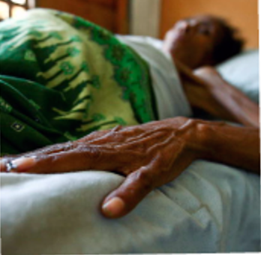
Caring for children versus caring for the sick
What do you choose?

Slide 9


Unpaid domestic work
What do you choose?

Slide 10
Multi-faceted character of the motivation to care:
One can take care of others out of love, but also because:
One feels responsible for others
It is seen as one’s job
There are no alternatives
Care is often provided free of charge (unpaid) in close networks involving care of family members, friends and neighbours.

Slide 11
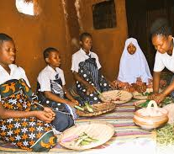
Cultural dimensions of care
In addition to the relevance of those materials conditions, it should be stressed that caring is not a homogeneous notion. Each society can be said to have its own overall culture of care.
Caring is intimately related to moral norms that define what good care is, who must care, who must be cared for, and so on. And within each society, diverse cultures of care may coexist.

Slide 12

The two components of the care economy
01
PROVISION OF UNPAID CARE
WORK BY HOUSEHOLDS
AND INDIVIDUALS
PAID JOBS IN THE
CARE SECTOR
02

Slide 13



Changes in care needs over a lifetime
2 years
12 years old
Two-year-olds still need assistance with bathing, clothing eating and in many cases moving around/walking.
At 12 years old, the situation varies greatly depending on whether the person is a girl or a boy, or from a worse-off or better-off family. While in some contexts at that age, a child’s only obligation is to attend school, in other (mainly girls) are expected to take responsibility for tasks such as washing and ironing clothes..
72 years old
When aging, individuals might become senile and in need of total care, but it is just as possible that they are still working. If we are fortunate at this age one would be retired and receiving a pension, but at the same time might be doing unpaid care work, such as looking after grandchildren.. Women are less likely to receive a pension than men because the care work they perform during their lives does not entitle them to this benefit; they are also more likely to be taking care of others.
42 years old
Most people aged 42 years are able to take care of themselves and others. Often at this age, there are children, grandchildren and parents to care for. However, for men, it is likely that more time will be devoted to paid work and less to caring responsibilities. For women ,it is likely that caring responsibilities will be significant.

Slide 14
Why we need unpaid work
  Some unpaid care and domestic work is extremely rewarding
  Some unpaid care and domestic work is a drudgery
  But all unpaid care and domestic work is socially necessary to
      prepare people for income-generating activities during the day, thus ensuring the household's well-being
      raise children to want to assume their household and social responsibilities, thus building human and social capital
      “produce” labor, which is an input into all economic activity, along with capital
Notes:
Builds on previous slide – unpaid work is the basis on which the rest of the economy is built.

Slide 15
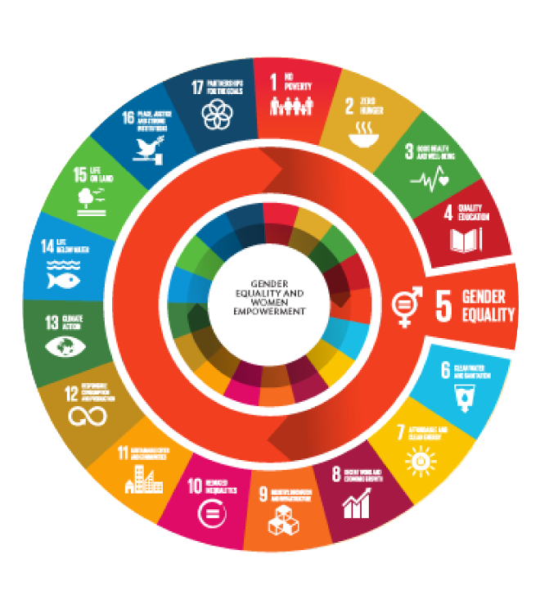
The 5R strategy
SDG target 5.4 through the so-called ‘3-R strategy’: Recognize, Reduce and Redistribute unpaid care work.
  Recognize
  Reduce
  Redistribute
  +Reward
  +Represent care workers
calls for actions to go beyond merely increasing the visibility of unpaid work as a policy issue to also include policies to alleviate the care burden and divide it between women and men, and families and public/market services in a more balanced and equitable manner and providing better and more visible employment to care workers (decent work).
Notes:
Slide introduces the 3R strategy, with specific examples of policies on each of the 3Rs to be discussed in the following slides.

Slide 16
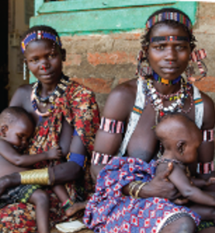
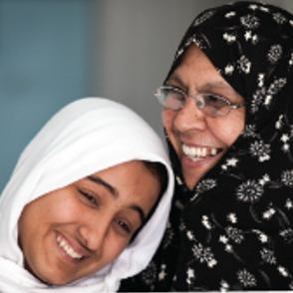
Demography
Women are most
often caregivers
Children and the elderly the main recipients of care

Slide 17
Children and elderly in the population
Population Pyramid, Kenya 2019
Population ageing is happening globally, with the elderly forming a relatively high percentage of the population. On the African continent in general the majority on the population is still young.
The population pyramid of the population of Kenya shows that the majority of the population is below 24 years of age. This means that at present the bulk of the care economy and care work has to be aimed at children. However, since fertility rates (number of children per woman) have been declining and life expectancy increase this will be changing in the coming decades. It is important to already start to think and prepare for the coming care economy needs of older people.
Source: KNBS Population Census 2019

Slide 18
Children and elderly in the population, according to the population prospects of the UN Population Division
Population ageing starts to have an impact from 2020, and particularly 2030 onward, while the weight of population aged 0-5 remains at a maximum until 2050/60 when a slight decrease starts occurring
Source: UN Population Division 2019 Medium variant

Slide 19
Public policies, particularly infrastructure policies, impact on care
Key questions
A
INDIVIDUAL AND TEAM INTERACTIONS OVER PROCESSES AND TOOLS
1
Is infrastructure adequate for care?
2
Do housing, urban infrastructure and urban policies impact on care?
3
Does sexual and reproductive policy recognize care needs?

Slide 20
Cultural norms can affect all aspects of care, from who engages in care to how the state and individuals support those who need care.

Slide 21
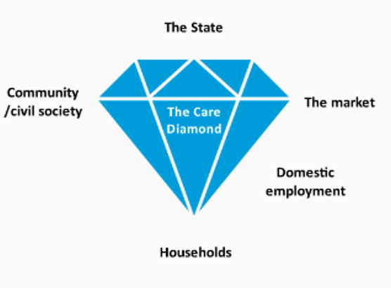
The care diamond
Notes:
There are four institutions that can provide society with care:
The state
The market
The community/civil society sector
Households
Together the add up to the ‘care diamond’
Domestic employment is located halfway between market and the households.

Slide 22
Challenges for organizing care
COMMODIFIED
VS UNPAID
STATE and
HOUSEHOLD
In some societies care is paid for and sometimes at very high prices - in others paid care is not always available.
In some countries the state participates significantly in providing care; in others the burden falls almost entirely on households.
02
01
FEMINIZED
OCCUPATIONS
03
When care is paid for it is still an activity linked to women and undervalued.
EXTENDED
FAMILY AND
COMMUNITY
05
04
The community or extended family can play an important role in spreading care work.
SHIFTING
COMPONENTS
When clothes are bought and convenient foods consumed the nature of care and its components change.

Slide 23
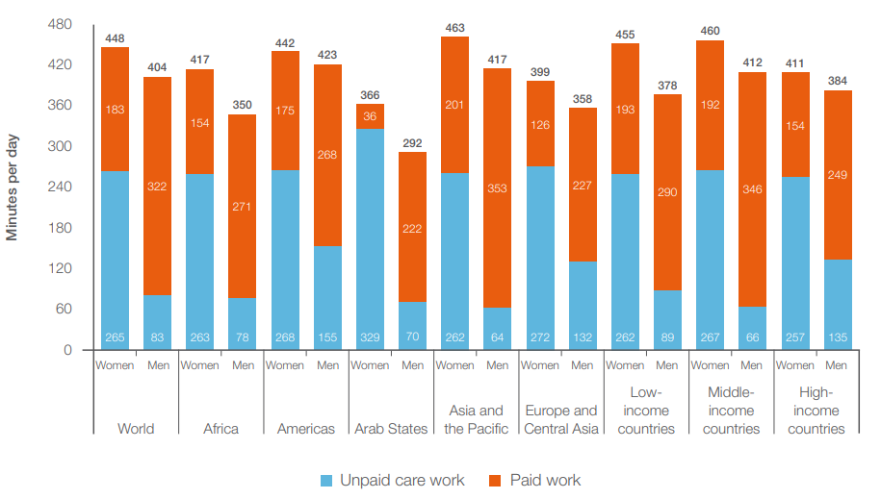
There are huge gender inequalities when it comes to time spent on unpaid work
Source: ILO (2018)
Notes:
In every part of the world – even Europe/North America– women spend more time on unpaid work than men.
Source: https://www.ilo.org/wcmsp5/groups/public/---dgreports/---dcomm/---publ/documents/publication/wcms_633135.pdf

Slide 24
  Key take aways
    Women tend to bear the brunt of unpaid and care work
    While unpaid work is economically important, it prohibits women from entering or fully participating in the labour force
    Effective policies focus on the 5R strategy: recognize, reduce, redistribute unpaid work as well as reward and represent unpaid care workers.
Notes:
This slides summarizes what will be done in the lecture. Roughly, the outline is centered around the following questions: (1) What is the problem? (2) Why do we care? (2) What has and can be done about it? There are several linkages to the presentation on Employment, decent work and social protection, which can be emphasized from the start.

Slide 25
References
Folbre, 2006. Measuring Care: Gender, Empowerment, and the Care Economy, Journal of Human Development, 7:2, 183-199, DOI: 10.1080/14649880600768512
Ilkkaracan, 2013. A Policy Option for Sustainable and Equitable Development in Turkey: Public Investment in Social Care Services. Available from https://www.ilo.org/wcmsp5/groups/public/---europe/---ro-geneva/---ilo-ankara/documents/publication/wcms_477313.pdf
Ilkkaracan, 2016. A feminist alternative to austerity: the purple economy as a gender-egalitarian strategy for employment generation. In Economics and Austerity in Europe, 1st edition, published by Routledge
ILO, 2018. Care work and care jobs for the future of descent work
KNBS 2019. Population Census. Available from http://housingfinanceafrica.org/app/uploads/VOLUME-II-KPHC-2019.pdf
UNDESA 2019. Population projections. Available from: https://www.eea.europa.eu/data-and-maps/indicators/total-population-outlook-from-unstat-2/assessment#:~:text=The%20total%20population%20of%20the,under%20'medium%20fertility'%20assumptions.
UN Women, 2018. Issue paper: Recognizing and investing in the care economy https://www.unwomen.org/sites/default/files/Headquarters/Attachments/Sections/Library/Publications/2018/Issue-paper-Recognizing-and-investing-in-the-care-economy-en.pdf
UN Women/ILO, 2021. A guide to Public Investments in the Care Economy. Policy Support Tool for Estimating Care Deficits, Investments Costs and Economic Returns, Policy Tool.
Visualizations: Infographia

Slide 26
Thank You

