Slide 1
Gender budgeting: Expenditure analysis. A case study of Uganda
Africa Gender Statistics Forum (AGSF) November 2023
Casablanca, Morocco
8th November 2023
Leila Ssali
Senior Economist (Monitoring and Evaluation)
Ministry of Gender Labour and Social Development

Slide 2
Introduction
The Equal Opportunities Commission (EOC) is a constitutional body established by the Equal Opportunities Commission Act, No. 2 of 2007 (EOC Act)“to give effect to the State’s constitutional mandate to eliminate discrimination and inequalities against any individual or group of persons on the ground of;
sex, age, race, colour, ethnic origin, tribe, birth, creed or religion, health status, social or economic standing, political opinion or disability,
and take affirmative action in favour of groups marginalised based on gender, age, disability or any other reason created by history, tradition or custom for the purpose of redressing imbalances which exist against them; and to provide for other related matters”.

Slide 3
Introduction…ctd
The EOC assesses the National Vote and LG Budget Framework Papers and Ministerial Policy Statements to establish the level of compliance with gender and equity provisions.
Over the years, Uganda has witnessed increased funds allocated to most MDAs that primarily provide social services to the most vulnerable, including women, girls, children, PWDs, older Persons, the poor, and youth.
Notable among the MDAs that registered budget increases were Local Governments (Extension Services), Uganda Cancer Institute and National Environment Management Authority.

Slide 4
Capacity building in Gender and Equity planning and Budgeting
The Commission has so far trained over 2,500 technical staff and political leaders in Gender and Equity planning and Budgeting (GEB).
The training was varied based on demand, identification of capacity gaps during the GEB compliance assessments, technical backstopping across all the 148 MDAs and 179 Local Governments to undertake responsive planning and budgeting.
20 MDAs and 100 Local Governments have so far been trained in gender and equity planning using various forums.

Slide 5
Alignment of budgets to planning frameworks
In 2020/2021, the EOC aligned gender and equity assessment tools to the National Development Plan III and the new planning and budgeting structure for the Programme Based Budget Framework Papers.
In addition, the EOC developed a gender and equity assessment tool for the National Budget Framework Paper for the FY2021/22 to standardize the assessment process as per the PFMA Act 2015.
The Gender and Equity Management Information System (GEMIS) was upgraded and aligned to the National Development Plan III. The upgrade provides for online assessment for compliance with gender and equity and this has enhanced the effectiveness and efficiency of the assessment process.

Slide 6
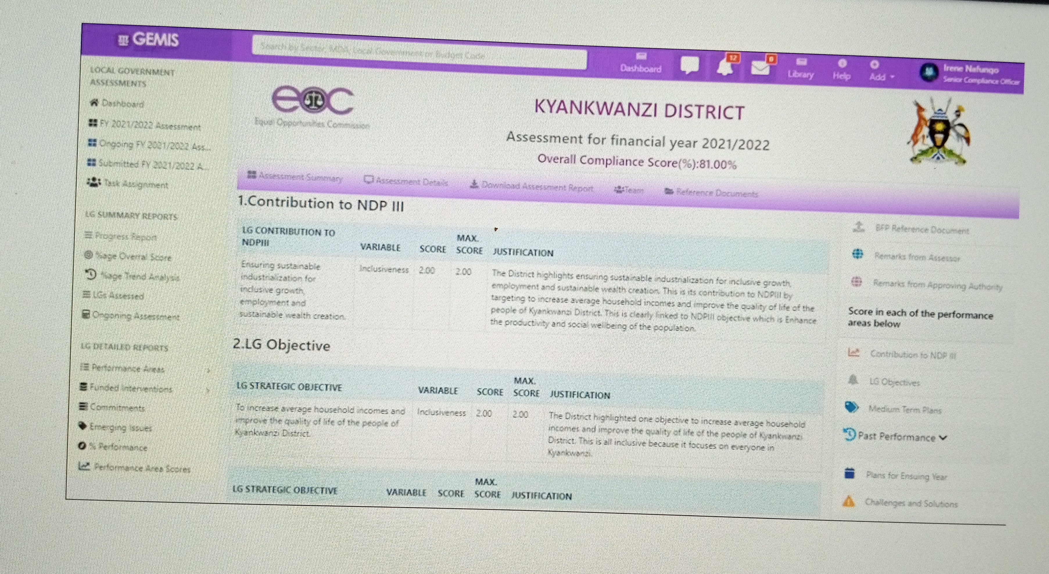
Gender and Equity Management Information System (GEMIS)

Slide 7
Gender equality and Equity Responsive Budgeting in all sectors and LGs
 | 2020/21 | 2022/23 | Target FY 2023/24
LGs complying with Gender and equity responsive planning and budgeting | 143 | 100 | 148
MDAs and LGs certified | 143 | 100 | 176
MDAs implementing G&E commitments | 20 | 80 | 80
By Q1 FY 2023/24, the proportion of MDAs that aligned BFPs to Gender and Equity Planning and Budgeting requirements was 54.35 %.
Proportion of MDAs that aligned MPSs to Gender and Equity Planning and Budgeting requirements was 67%.
Proportion of LG Budgets aligned to Gender and Equity Planning and Budgeting requirements was 58%.

Slide 8


