Slide 1
Data for Health (D4H) Initiative: Integrating Gender Equity
Ms Joan Sara Thomas
Gender Equity Focal Point
Technical Advisor for the CRVS and Global Grants Program
Data for Health Initiative at Vital Strategies
November 9, 2023
Parts of this presentation was adapted from content developed for the Gender Data Analysis Workshop co-developed by Vital Strategies, Data Impact Program and D4H partners

Slide 2
The Data for Health (D4H) Initiative
Bloomberg Philanthropies, in partnership with the Australian government, launched the Data for Health Initiative in 2015
Ultimate goal: Saving more lives by ensuring countries have more accurate public health information
The Initiative has five main programs:
Civil Registration and Vital Statistics (CRVS)
Data Impact
Global Grants Program (GGP)
Cancer Registry
Non-communicable Diseases (NCDs)
For more information: https://www.vitalstrategies.org/programs/data-for-health/

Slide 3
D4H Initiative Partners
Centers for Disease Control and Prevention
CDC Foundation
Global Health Advocacy Incubator
United Nations Economic and Social Commission for Asia and the Pacific
United Nations Economic Commission for Africa
Vital Strategies
World Health Organization
Johns Hopkins University- Gender Equity Unit

Slide 4
Partner Spotlight: John Hopkins University’s Gender Equity Unit
Strong theoretical background in gender as a health factor, intersectionality
1
3
Dissemination of gender data and outcomes
5
Complex gender data analyses
2
4
Development of gender-focused programs, policies
Collection of gender data and gender-related constructs
Email: team@genderhealthdata.org
Slack Channel: d4hgenderequityunit.slack.com
LinkedIn: www.linkedin.com/company/gender-equity-unit-of-the-data-for-health-initiative
Twitter: @jhugenderequity

Slide 5
Outline
Definitions: Equality, Equity, Justice and Gender Equity
Overview of Sources of Data
Lessons learned from mainstreaming Gender Equity into CRVS Systems
Sharing useful resources

Slide 6
Definitions

Slide 7
From Equality to Equity and Justice
REFERENCE: Ruth 2019

Slide 8
What is Gender Equity?
The process of being fair to all people, regardless of identity, sex or other dimension and importantly the equality of health outcomes and quality of life.
It is concerned about the fair and just treatment of all and considers the different needs, cultural barriers, and discrimination of any one specific group

Slide 9
Why is this important for health?
Without accurate, inclusive statistics, it is impossible to assess the magnitude of the problem we face
With incorrect data, we can not develop targeted policies and strategies and are at great risk of allocating limited resources incorrectly
This data gap leaves us unable to assess how well we are meeting the health needs of our people further exacerbating the ‘Scandal of Invisibility’

Slide 10
Good sources of data

Slide 11
Health-related data landscape in a country
Resource record systems
Individual record systems Service record systems
Household surveys
Census
Health Information System
Routine Health Information System – Institution-based services
Individual-level data
Health Management Information Systems
Logistics Management System, Stocks
Electronic Medical Records
Registers
Community Health Information System
Integrated Disease Surveillance
Finance
Facility surveys / Monitoring
Civil Registration and Vital Statistics
Vital events
Laboratory Information Management System
Human Resources

Slide 12
Advantages and Disadvantages of Routine Health Information Data
Advantages | Disadvantages
Readily available | Not always up-to-date (dependent on when collected)
Low Cost | Lack of completeness
Useful for identifying hypotheses (sex, age, cohort, geographic variations) | Some variables of interest might not be collected
Provides baseline data | Occasionally subject to political influences and manipulation
Useful for identifying areas of further research
Useful for initial assessment

Slide 13
Types of public health data
Input / Process
Health workers
Output
Intervention:
Outcome
Impact
Intervention:
Improved health
Infrastructure/IT
Supply chain information
- Access
- Quality
- Efficiency
- Coverage
Prevalence of risk factors and behaviors (Determinants of health)
outcomes
Improved equity (Health status)
Administrative records
Health service records
Population-based surveys
CRVS
REFERENCE: O'Neill, 2016

Slide 14
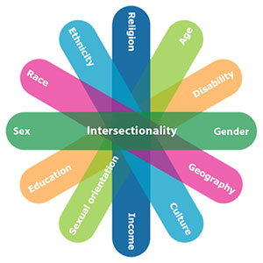
Intersectionality: Getting at the Why?
Gender is only one dimension that can shape power dynamics in society
Hierarchies related to sexual orientation, class, race, ethnicity, education, age, (dis)ability, religion, citizenship status, etc. also affect health outcomes
Intersectionality: These different dimensions often have a multiplier effect

Slide 15
Public Data Repositories

Slide 16
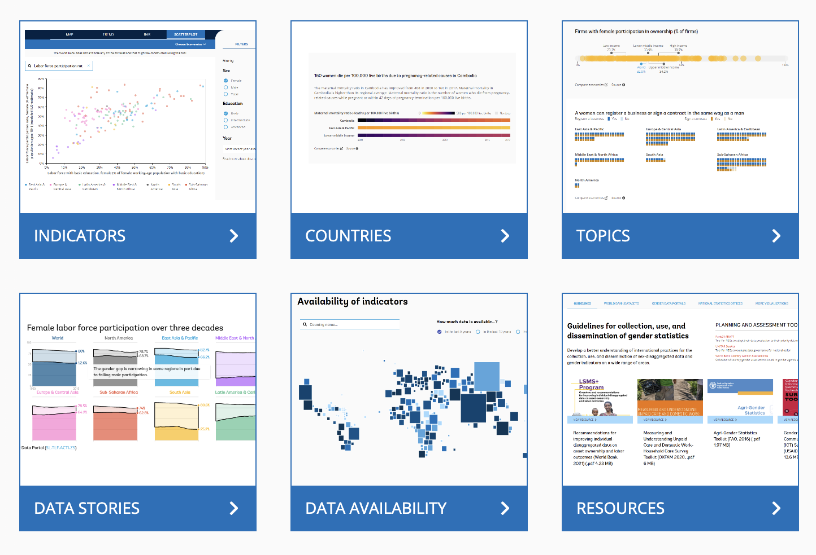
World Bank Gender Data Portal
REFERENCE: https://genderdata.worldbank.org/

Slide 17
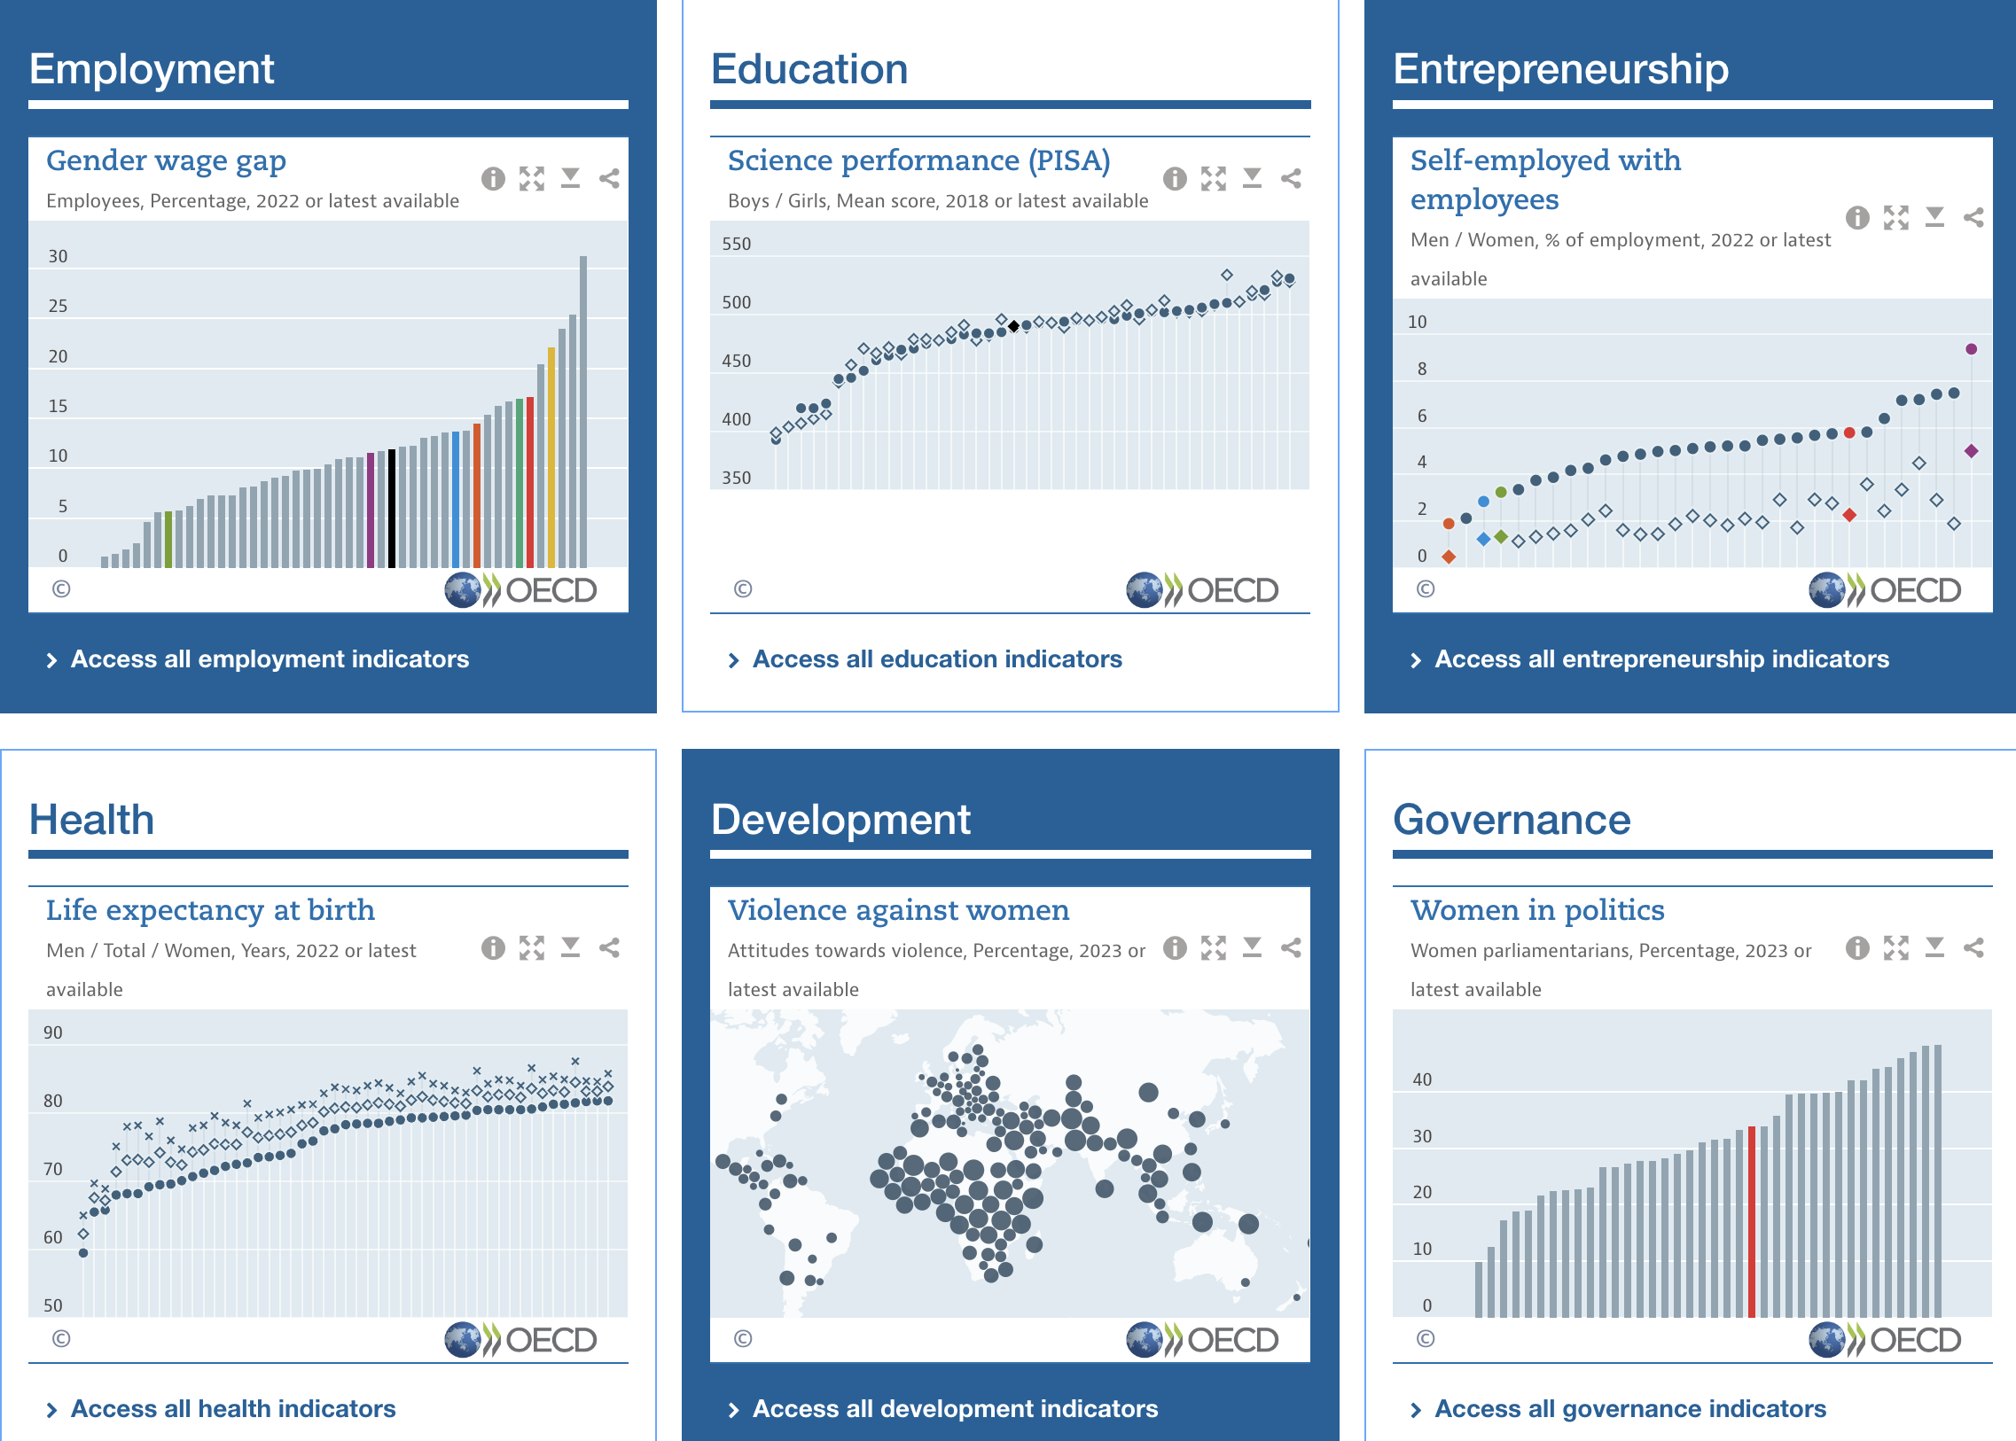
OECD Gender Data Portal
REFERENCE: https://www.oecd.org/gender/data/https://www.oecd.org/gender/data/

Slide 18
WHO HEAT Tool
REFERENCE: https://openwho.org/courses/health-equity-assessment-toolkit

Slide 19
The example of gender mainstreaming in CRVS System Strengthening Efforts
Lessons learned from D4H

Slide 20
Imagine this:
1.1 billion people worldwide, including 450 million women and girls, lack proof of legal identity
There are close to 70 million children below 5 years of age whose births have not been registered and even a larger number do not have official birth certificates.
Only 1 in 10 deaths is registered and only a fraction have a reliable cause assigned
There is no accurate record of how many children are born or die each day in most of these countries or how many girls are married off early or become victims of social crisis /gender related violence.
Notes:
Reference: https://apai-crvs.uneca.org/sites/default/files/resourcefiles/The%20Moving%20Elephant%20in%20Africa_Eng_0.pdf

Slide 21
Civil registration and vital statistics (CRVS) and equity
Sound CRVS data provides the most accurate assessment of population health
CRVS systems provide baseline data
CRVS systems provide data for ongoing monitoring and reporting (nationally and internationally: age at marriage, life expectancy, cause-specific mortality, etc.)
CRVS data are used to guide policy and budget allocations
CRVS data can tell us who are being missed

Slide 22
The life course approach
LIFECOURSE
BIRTH
MARRIAGE
DIVORCE
DEATH
Gender-Biased Sex Selection
Adolescent pregnancy
Child Marriage
Gender Equality
Preventable Maternal Deaths
Gender Equality
Women's Empowerment
Intergenerational Impacts

Slide 23
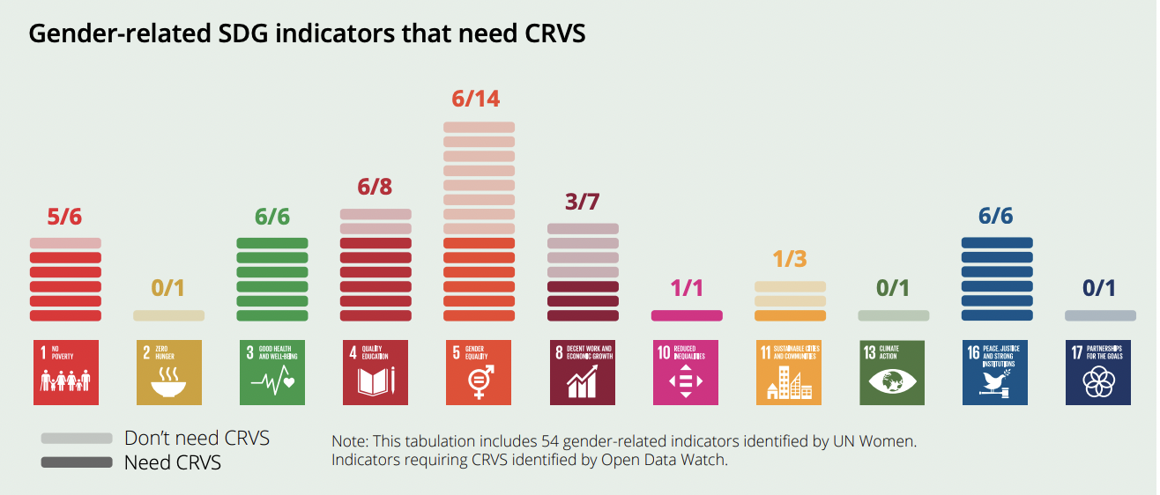
CRVS System Data: Monitoring Gender – related SDGs
Of the 54 explicitly gender-related indicators, 34 are derived from CRVS data

Slide 24
Specific Lessons Learned
Critical considerations

Slide 25
Critical considerations
1. Need to review our Legal and Regulatory Frameworks:
Systematic review of national frameworks against international best practices can ensure gender equity and help achieve universality in civil registration services
Will help identify and develop home-grown solutions to institutional, legal and financial constraints to ensure gender mainstreaming in CRVS systems
Toolkit: https://www.advocacyincubator.org/what-we-do/our-public-health-advocacy-programs/civil-registration/legal-and-regulatory-review-toolkit-for-crvsid
2. Inter-agency coordination mechanisms
Establish or strengthen inter-agency coordination mechanisms and ensure inclusion of ministry responsible for gender
Consider engagement of other relevant CSOs as per country context
Guidance Document: https://www.vitalstrategies.org/resources/guidance-for-civil-registration-and-vital-statistics-governance-mechanisms/

Slide 26
Critical considerations
3. Gender Lens to Business Process Mapping and Improvement
Conduct a comprehensive assessment of CRVS systems to understand current processes and identify gender biases and root causes of gender inequity
The process will help countries prioritize focus areas for improvement to ensure universality
Guide: https://www.vitalstrategies.org/resources/crvs-systems-improvement-framework/
4. Cause of Death Data
Strengthen capacity of CRVS stakeholders and health workers on MCCD and ICD coding to properly identify variations and causes of death of concern.
Strengthening data sharing linkages between key CRVS systems (e.g. health sector and medico-legal death investigation systems) to shed light on the often invisible burdens of violence many times suffered by women.
Guidance document:https://iris.who.int/handle/10665/341911?locale-attribute=es&show=full
Guidance Document: https://www.vitalstrategies.org/resources/the-health-sector-in-civil-registration-options-and-methods-to-increase-registration-of-live-births-stillbirths-and-deaths/

Slide 27
Critical considerations
5. Gender data analysis for improved policy making
Incorporating gender lens in the production of routine analytical vital statistics reports
Ensuring gender statistics accessible to all users; and unbiased gender vital statistics are appropriately disseminated
Data Impact Program Resource Site: https://www.d4hdataimpact.org/
Guide: https://assets.website-files.com/5d7f96ea4cc8598434877fed/64f9c85f14d73468d96c71a3_Production%20process%20-%20guide.pdf

Slide 28
Key Takeaways
Routine data are readily available and an important source when doing gender data analysis
Triangulating data with other sources will provide a more comprehensive health picture
Many repositories and portals exist for gender data, but need to be interpreted appropriately
Gender data analysis is a prerequisite to the strategy of gender mainstreaming
Sustained leadership and commitment is required for gender-transformative CRVS system strengthening that addresses the many issues that arise throughout the life-course of an individual
CRVS systems are a foundational source available to all governments and strengthening them is a worthy investment !

Slide 29
Resources Available
CRVS Legal and Regulatory Toolkit: https://www.advocacyincubator.org/what-we-do/our-public-health-advocacy-programs/civil-registration/legal-and-regulatory-review-toolkit-for-crvsid
Guidance for CRVS governance mechanisms: https://www.vitalstrategies.org/resources/guidance-for-civil-registration-and-vital-statistics-governance-mechanisms/
Health Sector in Civil Registration options and methods to increase registration of live births, stillbirths and deaths: https://iris.who.int/handle/10665/341911?locale-attribute=es&show=full
Health sector contributions towards improving the civil registration of births and deaths in low-income countries: guidance for health sector managers, civil registrars and development partners: https://www.vitalstrategies.org/resources/the-health-sector-in-civil-registration-options-and-methods-to-increase-registration-of-live-births-stillbirths-and-deaths/

Slide 30
Civil Registration Improvement Framework: https://www.vitalstrategies.org/resources/crvs-systems-improvement-framework/
Technical Guidance for Strengthening the Vital Statistics Production Process: https://assets.website-files.com/5d7f96ea4cc8598434877fed/64f9c85f14d73468d96c71a3_Production%20process%20-%20guide.pdf
Global Grants Program: https://www.d4hglobalgrantsprogram.org/
Data Impact Program resource site: https://www.d4hdataimpact.org/
John Hopkins University: Gender Equity Unit
Learn/Do/See sections organized by data collection, analysis and impact: www.genderhealthdata.org; Gender Foundations in Health Data Course: Free online course thru the Johns Hopkins Coursera channel – with a certificate of completion

Slide 31
Thank you

