Slide 1
Using existing data to understand the gender-climate nexus
Gender Statistic Forum, November 7-11, 2023
Casablanca Morocco
Prepared by Sara Duerto Valero
Sara Duerto Valero
Regional Office for Asia and the Pacific
UN Women

Slide 2
Data: Integrating pre-existing datasets
Merge pre-existing datasets using unique identifiers (e.g. primary sampling unit/cluster no. , latitude, longitude)
Merge DHS data with Geospatial information
Latest available estimates for both GIS and DHS data
Two step approach: (1) Random Forest : to identify key variables ; Binary logistic regression : to explore nature of associations
Global Self-consistent, Hierarchical, High-resolution Geography Database
UNDRR’s Global Disaster Risk Dataset
DHS women’s file
DHS Geocovariates
Child marriage rates
Adolescent births rates
Prevalence of intimate-partner violence in past 12 months
Access to basic drinking water sources
Access to clean cooking fuels.
Age
Wealth
Location
Employment status
Ethnicity
Proximity to national border
Proximity to protected areas
  Avg. day land surface temperature
  Drought episodes
  Avg. annual rainfall
  Aridity index
  Probability of riverine flood
  Proximity to lakes
  Proximity to ocean coastlines
Dependent variables
Control variables
Independent variables

Slide 3
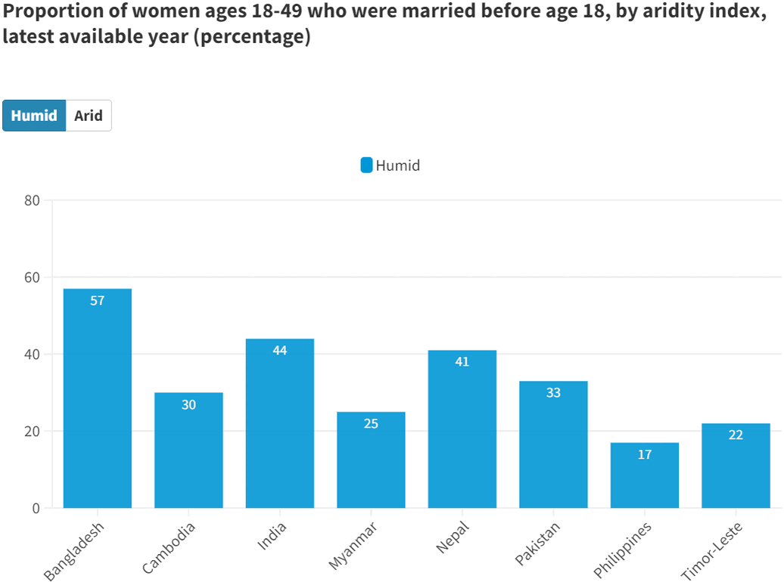
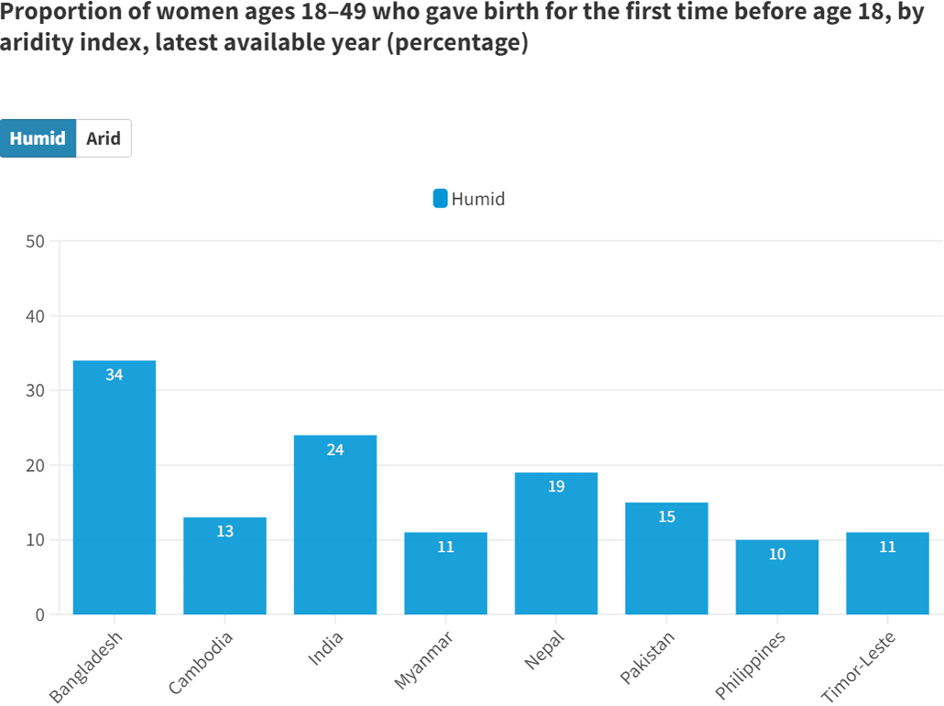
Aridity explains changes in child marriage and adolescent birth rates

Slide 4
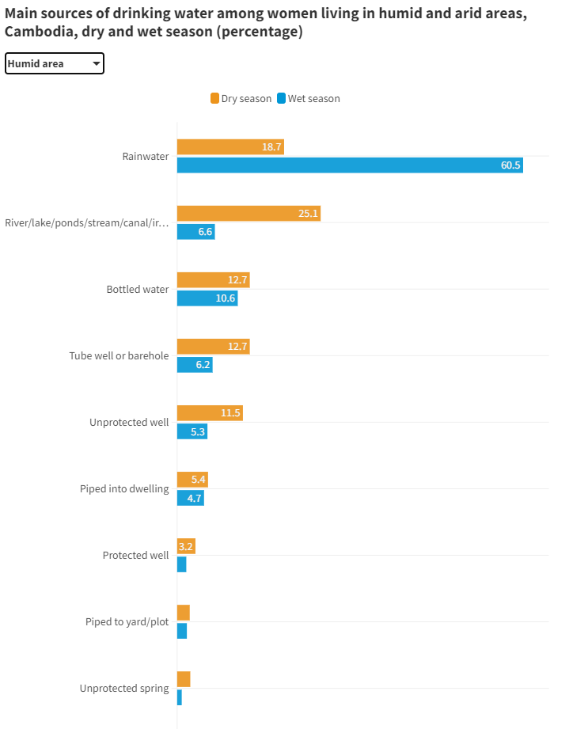
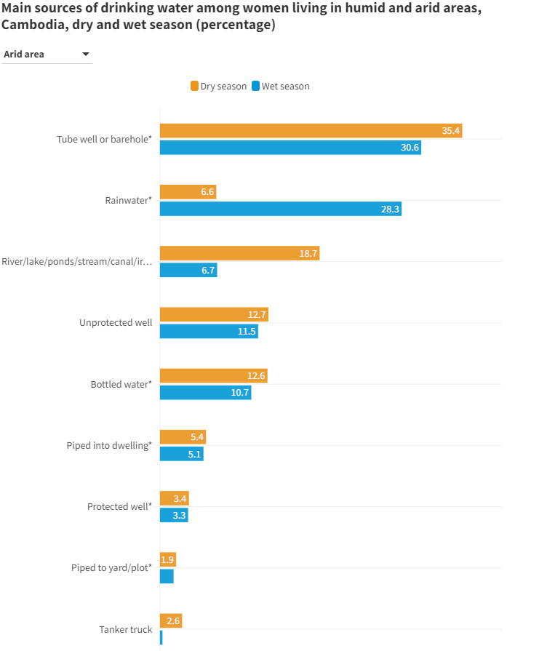
Aridity matters for access to clean drinking water, especially in humid areas

Slide 5
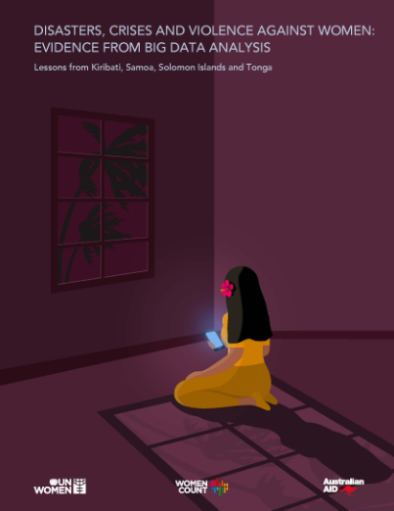
Data: Analyzing big data
Using Google search data
Indexation of VAW related wording
Search classification:
  General searches
  Victim searches
  Help-seeking searches
Translation to local languages
Comparing with real time events

Slide 6
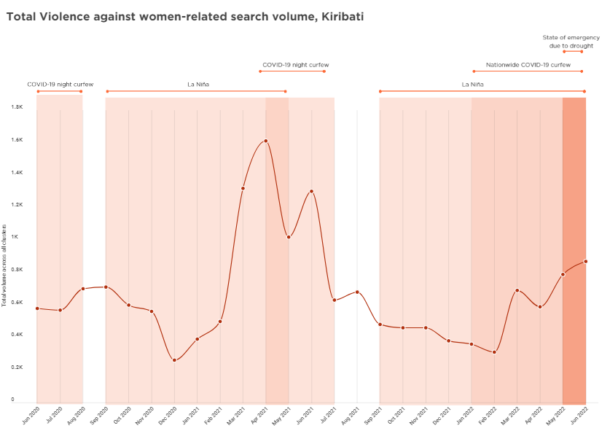
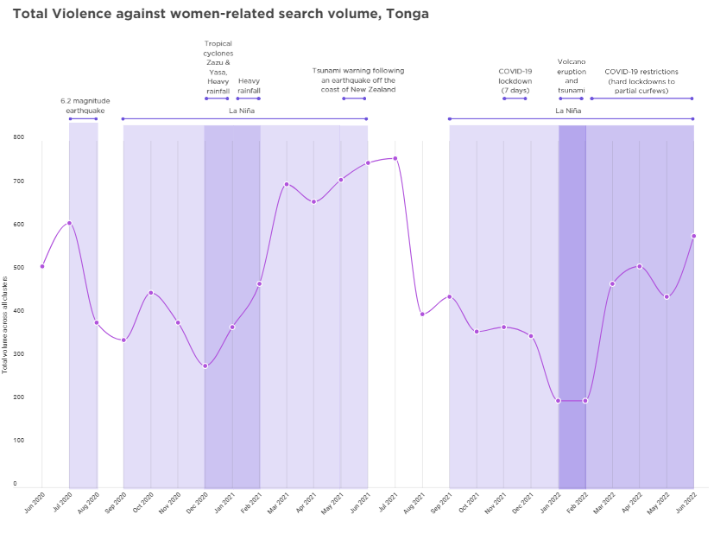
Women are more likely to seek VAW related help on-line during crises

Slide 7
https://data.unwomen.org/features/why-climate-change-matters-women

Slide 8
Measuring the nexus between gender and the environment
Survey developed by UN Women in
in close consultation with FAO, ILO, IUCN, UNEP, UNDRR and UNESCAP.

Slide 9

Sampling methods and survey operations: Measuring the nexus between gender and the environment
https://data.unwomen.org/publications/sampling-methods-and-survey-operations-measuring-nexus-between-gender-and-environment

Slide 10

Enumerator Manual: Measuring the nexus between gender and the environment https://data.unwomen.org/publications/enumerator-manual-measuring-nexus-between-gender-and-environment

Slide 11

Model questionnaire: Measuring the nexus between gender and environment
https://data.unwomen.org/publications/model-questionnaire-measuring-nexus-between-gender-and-environment

Slide 12
Household questionnaire
  Module 1 Household roster
  Module 2 Housing characteristics: Location, building materials, fuel, water and sanitation
Individual questionnaire (1 woman, 1 man 15 + / HH)
  Module 3 Individual characteristics
  Module 4 Disaster exposure, preparedness and consequences
  Module 5 Exposure to, and preparedness for, climate change related effects
  Module 6 Employment in the green economy
  Module 7 Agriculture and land use
  Module 8 Environment-related livelihoods
  Module 9 Asset ownership
  Module 10 Decision making and mobility

Slide 13
Thank you
sara.duerto.valero@unwomen.org
isabella.schmidt@unwomen.org
michele.seroussi@unwomen.org

