Slide 1
Measurement of technology-facilitated violence against women
5th Regional Workshop on Gender Statistics
Casablanca, Morocco
10th November 2023
Presented by: Diana Byanjeru
Senior Statistician, Gender & Disability Statistics

Slide 2
Content
Overview
Survey
Key findings
Conclusion
Challenges
Lessons learnt

Slide 3
Overview
Under Phase I of the Women Count Programme, the Uganda Bureau of Statistics undertook a number of activities to produce both administrative and survey data on GBV.
Among these were:
Measurement of technology-facilitated violence in the country using a survey.
Strengthening of administrative data on GBV

Slide 4
Survey - Introduction
Dedicated prevalence survey on violence.
Conducted in 2020 to 2021.
To provide up to date estimates of indicators on VAWG.
Included the first ever module on TF-VAW.

Slide 5
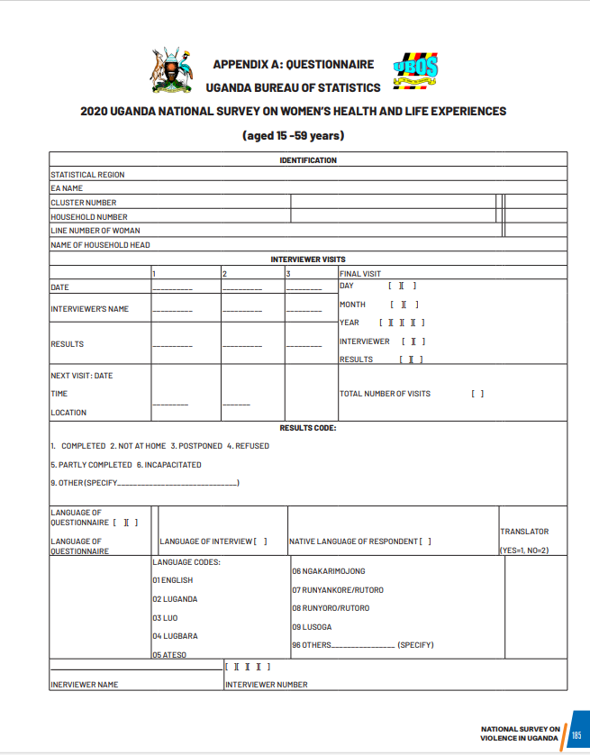
Survey – Introduction…
Adopted a ‘survivor centered approach’ with the highest standards of safety, security and confidentiality as guided by the WHO (2001) recommendations.
For example, in the naming of the survey.
Adopted a highly participatory approach.

Slide 6
Survey – Sub sample
Own a mobile telephone, or
Have ever used internet

Slide 7
Survey - Forms of TF-VAW
Sharing clear images of the women without her consent.
Sending women clear unwanted images that they did not ask for.
Use of unwanted sexually obvious emails or other messages.
Offensive advances in social media and other platforms
Use of hate speech (degrading, insulting, threatening language or language that targets someone based on their sex, disability status, tribe, religion etc

Slide 8
Survey – Questions on TF-VAW
Asked in respondent’s background section:
Have you ever:
received or sent unwanted sexually obvious emails or other messages?
received or made offensive advances in social media and other platforms?
been threatened or threatened someone of physical or sexual violence through the internet?
received a hate speech meaning language that degrades, insults, threatens or targets you based on your gender and/or other traits?

Slide 9
Survey – Questions on TF-VAW…
Have you ever experienced any of the following?
Someone sharing clear images of you without your consent.
Someone sending you clear images that you did not ask for.
if all (5 questions) are no, (code 2) skip to …
In which of the following online environments did your most recent experience occur? (list provided)
Thinking of the person or people involved, how did you know them? (list provided, check all that apply)

Slide 10
Survey – Characteristics collected
The respondents’ biodata;
Ownership and use of ICT gadgets;
Different forms of cyber harassment;
Involvement in cyber harassment – victim or perpetrator;
Online environment
Relationship to perpetrator

Slide 11
Key Findings
Women who have ever been involved in cyber harassment (%)
49

Slide 12
Challenges
Limited collection of additional information (such as device/means, platforms and digital spaces, frequency/repetition of the violation, impacts/harms suffered, and reactions to/reporting of TF-VAW), as it was not a stand alone survey.
Limited exploration of the causes and effects of exposure to violence, due to the cross-sectional design of the survey.
Whereas a qualitative study was conducted to support interpretation of the quantitative findings, information was not collected on TF-VAW.

Slide 13
Lessons learnt
Rigorous interviewer training contributed to disclosure.
The participatory approach used contributed to the quality of the data, and effective implementation of the Study. It further created a link to the policy process, and ensured a wider ownership and interest in the study results at the country level.
Emphasis on ethical and safety concerns also contributed to the quality of the data, and to the effective implementation of the Study.

Slide 14
Conclusion
A number of issues would benefit from further exploration with qualitative studies, and further analysis.
Whereas efforts towards strengthening of administrative data on GBV were not specific to TF-VAW, a solid foundation was laid for measurement of the same, as an emerging issue.

Slide 15
Thank You

