Slide 1
Gender statistics from Censuses
Overview of Census communication and dissemination toolkit and dashboard.
Africa Gender Statistics Forum, 7 - 11 Nov 2023
Pamela Kakande Nabukhonzo
ACS, UNECA

Slide 2
Presentation overview
Background
Africa’s population and housing census programme in the 2020 round
ECA’s census digital tools
Census communication and dissemination toolkit and dashboard

Slide 3
Background - African Centre for Statistics
Vision: Transforming Africa through Credible Data & Statistics
The core functions of ACS within which it aims to strengthen the African statistical System to measure socio-economic and environmental concerns :
Strengthen capacity of NSSs to produce, disseminate and use disaggregated data and statistics, with a gender dimension.
Improve availability of harmonized statistics in the Commission databases and enhance support to produce and disseminate comparable data and statistics.
Support member States in the production and use of timely geospatial data, information, and services.
Contribute to the setting up and undertaking of censuses and surveys.
Implement modern data collection practices using modern communications technology tools and methodologies to facilitate data capture.
Notes:
The core functions of ACS within which it aims to strengthen the African statistical System to measure socio-economic and environmental concerns :
a) Strengthen capacity of NSSs to produce, disseminate and use disaggregated data and statistics, with a gender dimension, to facilitate evidence-based policymaking, planning, implementation, monitoring and reporting.
b) Improve availability of harmonized statistics in the Commission databases and enhancing support to member States in their efforts to produce and disseminate comparable data and statistics.
c) Support member States in the production and use of timely geospatial data, information, and services for evidence-based decision-making in Africa.
d) Contribute to the setting up and undertaking of censuses and surveys and making the data and information available.
e) Implement modern data collection practices using modern communications technology tools and methodologies to facilitate data capture.

Slide 4
The 2020 Round of Censuses in Africa
1990 Round –44 countries
2000 round -38 countries
2010 round – 47 countries
2020 round – 27 countries
Developed Africa Programme (2015 – 2024)
Building technical capacity for the various phases of census operations
Providing direct technical support for census planning, management, data collection, processing, analysis and dissemination
Developing tools to support census operations.

Slide 5
Innovative digital census tools
Tablet provisioning system
A system for preparing devices for data collection
Field monitoring dashboard application
A system that provides information about census performance and real-time results
Census Issue tracking system
A system to enable field staff to submit issues directly through to the call center/helpdesk
Census project management
A system to easy management and monitor implementation of each census phase
Census results dissemination toolkit
A system to easy dissemination of disaggregated census results

Slide 6
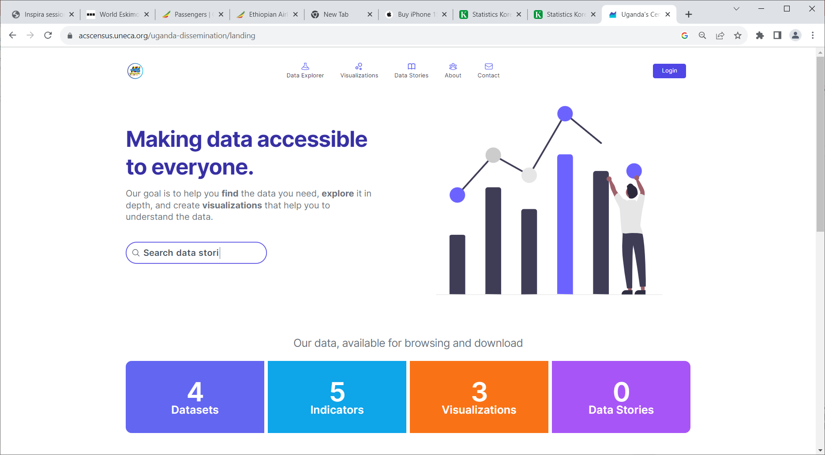
Census results dissemination toolkit
is a web application accessed with two components:
Content management
Public view

Slide 7
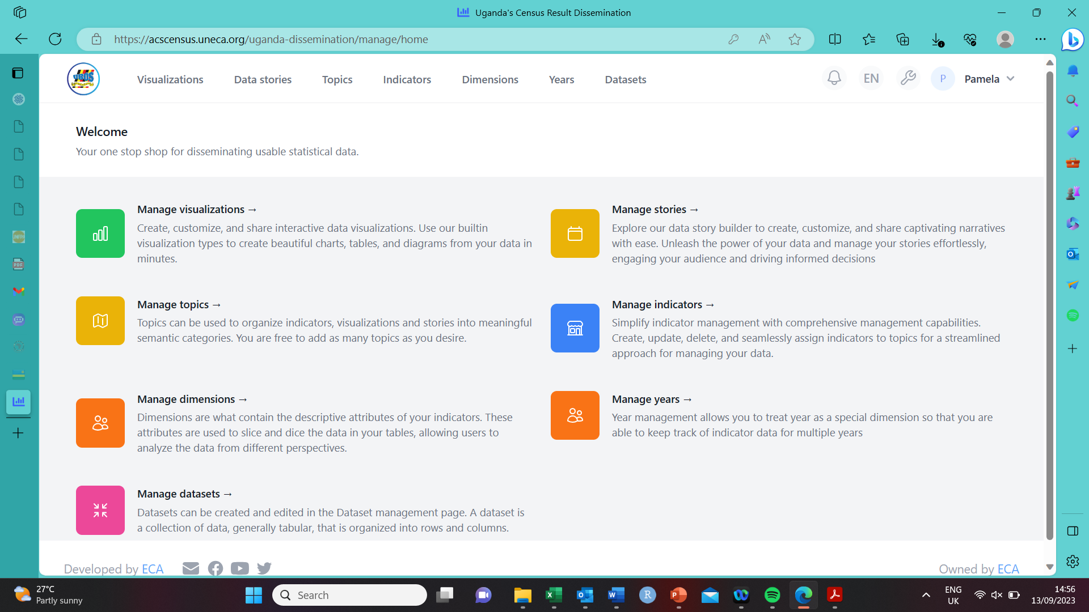

Slide 8
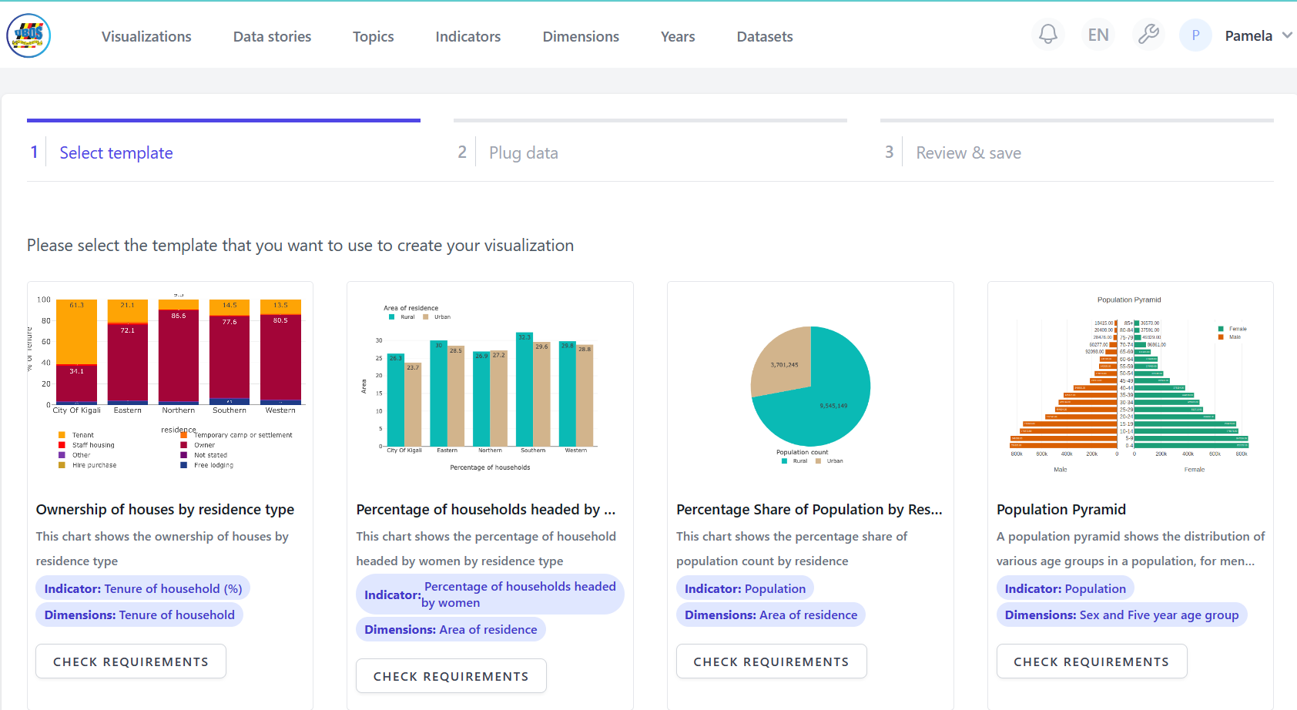

Slide 9
Census results dissemination toolkit
Features to explore census data to fill gender data gaps:
Management of microdata
Dynamic visualizations and data stories
Enables storage and presentation of census-related tables and reports.
Census Metadata Page: explaining the census, including questionnaires, dates, coverage, and other relevant details.
Allows for alerts, sending messages to individuals or groups, and making announcements.

Slide 10
How census data can fill gender data gaps
Provides a comprehensive picture of the population and addresses gender data gaps through:
Inclusion of gender related questions in census questionnaires.
Data disaggregation for the identification of gender-specific patterns, experiences, and disparities.
Intersectionality with other social categories such as ethnicity, disability, and socioeconomic status.
Geographic analysis to identify regional variations in gender-related issues.
Longitudinal analysis which helps track changes and trends in gender-related indicators over time.
Data sharing and collaboration with other relevant stakeholders.
Notes:
Inclusion of gender-related questions: Census questionnaires can be designed to include specific questions about gender identity and expression.
Census data can be disaggregated by gender to provide a more nuanced understanding of various population groups.
Census data can capture the intersectionality of gender with other social categories such as race, ethnicity, age, disability, and socioeconomic status.
Census data can be analyzed geographically to identify regional variations in gender-related issues.
Census data collected over multiple years allows for longitudinal analysis, which helps track changes and trends in gender-related indicators over time.
Census data can be shared with other relevant stakeholders, such as researchers, policymakers, and civil society organizations. By making census data accessible to a wide range of users, collaborations can be fostered to conduct further analysis, validate findings, and develop evidence-based policies and programs.

Slide 11
Conclusion
The census results dissemination toolkit and dashboard is a useful tool to enhance census data dissemination to fill gender data gaps .
For further information about the census dissemination toolkit, please contact: ecastats@un.org

Slide 12
Thank you!
Questions and comments: pamela.nabukhonzo@un.org

